Slide 1
Pennsylvania Chiefs of Police association

Slide 2
The Pennsylvania Law Enforcement Accreditation Program
Accreditation Manager Training

Slide 3
Audience
Individuals who are:
Prospective Accreditation Manager
New Accreditation Managers
Veteran Accreditation Managers

Slide 4
Focus Areas
Accreditation
What is accreditation?
How does my agency become accredited?
What does the process to become accredited involve?
What should I expect during an accreditation assessment?

Slide 5
Why are you here?
To understand:
Importance of accreditation
Accreditation Manager role
How to create and development an accreditation assessment
Mock accreditation assessment
Accreditation assessment (on-site)

Slide 7
Instructor
Leon Crone
Lower Allen Township Police Department
Captain
Accreditation Manager for
Pennsylvania Police Accreditation Coalition
Immediate Past President
Pennsylvania Law Enforcement Accreditation Commission
Assessor
Instructor
Member
Standards Committee
Member

Slide 8
Instructor
David Madrak
Upper Dublin Township Police Department
Corporal
Accreditation Manager
Pennsylvania Police Accreditation Coalition
President
Mock Coordinator ~ East
Pennsylvania Law Enforcement Accreditation Commission
Assessor
Instructor
Member
Standards Committee
Member

Slide 10
What is accreditation?
Established standard of performance, acknowledged business practices and professionally recognized organizational principles that are mandated as necessary for a particular profession or organization.

Slide 11
What advantages does accreditation provide to my agency?

Slide 12
Credible framework for evaluation of policy and procedure
Highlight agency capability and competency
Improved management procedures
Increased employee morale
Enhanced planning and innovation

Slide 14
Encourages problem solving
Improves law enforcement and community relations
Reduces agency risk and lawsuit exposure
Potential liability insurance savings
Agency accountability
Solid foundation for an agency to build upon

Slide 15
Who does accreditation begin with?

Slide 16
Executive Leadership
Chief of Police
Deputy Chief of Police, Captains, Lieutenants
Municipal administrators
Council, Commissioners, Supervisors
Manager

Slide 17
Accreditation program Overview
Who would want this?
What is it?
Why is it important?
Where can I find help?
When is my agency going to become accredited?

Slide 18
The application and Chief Executive Officer Responsibilities
Letter of Intent
Fee
$250.00

Slide 19
Notification to agency personnel

Slide 20
Who will be my agency’s accreditation manager?

Slide 21
What makes a good accreditation manager?
Interested
Organized
Dedicated
Innovative
Communication skills
Computer skills
Writing skills
Understand the role of “politics” within their agency
Knowledge of Agency Operations

Slide 22
Considerations when selecting an accreditation manager
Nomination Vs. Selection
Volunteer vs. Voluntold
Sworn vs. Non-Sworn
Rank vs. No Rank

Slide 24
Accreditation manager

Slide 25
1st Step – Training
Congratulations, you are here!

Slide 26
Responsibilities of the accreditation manager
As each item relates to accreditation
Conducts a “self assessment” of agency
Facility
Policies and procedures
Training
Develops or assists with the development of policies and procedures as they relate to accreditation
Ensures agency compliance to accreditation standards via Proofs of Compliance
Coordinates and facilitates accreditation assessments
Mock
On-site

Slide 27
Accreditation Standards
Address high profile and liability related issues

Slide 28
Accreditation standards
Organization and Management Role ~ Chapter 1
Law Enforcement Functions ~ Chapter 2
Staff Support Responsibilities ~ Chapter 3
Legal Mandates ~ Chapter 4

Slide 29
Accreditation Standards
139 total standards
38 – Organization and Management Role
42 – Law Enforcement Function
40 – Staff Support Responsibility
19 – Pennsylvania Legal Mandate

Slide 30
Organization and Management
Agency role and responsibilities
Authority
Direction
Planning
Personnel issues
Training

Slide 31
Law Enforcement Function
Patrol
Traffic
Legal Process
Court Security
Sheriff’s Office
Campus Security
College and University Police Departments
Eyewitness Identification

Slide 32
Staff Support
Cells
Temporary Holding
Communications
Records
Property & Evidence Control
Heath & Wellness

Slide 33
Legal Mandates
Crashes
Pursuits
Crime Victims
Missing Persons
Juveniles
Megan’s Law
Training
Domestic Violence
Etc.

Slide 34
Standard Components
Standard Statement:
1.2.2 A written directive governing procedures for assuring compliance with all applicable constitutional requirements for in-custody situations, including, but not limited to:
Interrogations
Access to counsel
Search and seizure

Slide 35
Standard Components
Standard Narrative:
Interrogations include interviews, questioning, or any other term used to describe in-custody verbal examinations requiring constitutional rights. These constitutional requirements, federal and state, are vital to the role and function of law enforcement in a free society. By complying with these constitutional requirements, law enforcement officers and law enforcement agencies ensure fair, legal, and equitable treatment of all people.

Slide 36
Standard Components – “If”
Standard Statement:
1.3.3 A written directive regarding the use of firearm “warning” shots by agency personnel.

Slide 37
Standard Components – “If”
Standard Narrative:
If firearm “warning” shots are permitted by the agency, then it is necessary for the agency to define under what circumstances. Otherwise the directive should prohibit the discharge of “warning” shots by agency personnel.

Slide 38
Not applicable (N/A) standards
Certain standards require proof of a negative (i.e. “warning” shots). This will usually be defined in the standard, narrative, or the Sample Assessment. In these cases you need a policy prohibiting the act and cannot take as a N/A.

Slide 39
Waiver from compliance
Waiver available for two (2) different reasons:
Compliance must be IMPOSSIBLE:
Conflict with Collective Bargaining Agreement or local ordinance
New standard within six (6) months of scheduled accreditation assessment

Slide 40
Self assessment of Agency
Longest phase of Accreditation Program
Compares agency policy to standards
Creation or revision of policies
Training of personnel
Proofs of Compliance are gathered
Forms
Incident or Investigative Reports
Observation
Mock Accreditation Assessment
Determines readiness for accreditation assessment

Slide 41
“I’ve begun writing a new policy manual; I have the pages numbered, now all I must do is fill in the rest!”

Slide 42
How can I locate a "good” policy or proof of compliance?

Slide 43
Resources
Sample Assessment
Power DMS – Pennsylvania Chiefs of Police Association
https://powerdms.com/ui/login.aspx?formsauth=true
Accredited agencies
Agency’s insurance provider
Professional services

Slide 44
Do your Agency’s policies or proofs of compliance “Meet the mark”?

Slide 45
“Countless unseen details are often the only difference between mediocre and magnificent.”

Slide 46
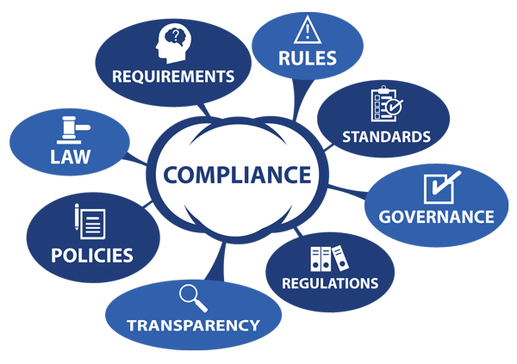
Proving compliance
Compliance needs to be demonstrated through:
Written Directive
Policy = Standard (to include bullets)
Written Documentation
Form, Incident or Investigative Report, Observation

Slide 47
Written directives
Need to “match” or “mirror” the standard

Slide 48
Written Documentation (AKA – Proofs of Compliance)
Certificates
Emails
Forms
Interviews (Limited Basis)
Incident & Investigative Reports
Lesson Plans
Memorandums (Memo-to-File)
Observation
Video

Slide 49
Interviews
Chief of Police
Evidence Custodians
Internal Affairs
Trainers
Defensive Tactics
Firearms
Less Lethal Weapons

Slide 50
Memo-to-file (MTF)
Memorandums
Commonly utilized to demonstrate that none or only one (1) Proof of Compliance is present.
No police officers were hired during the accreditation year
Only one (1) police officer was hired during the accreditation year
May also be used for clarification when Proofs of Compliance require some additional explanation

Slide 51
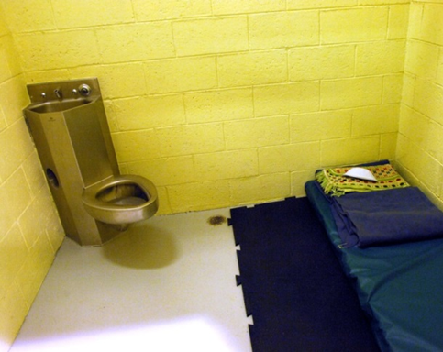
Observation (O)
Select standards
Tour
Checklist
Recommend that photographs are placed into “observational” files

Slide 52
Commission on Law Enforcement Accreditation (CALEA)
“Crosswalk”

Slide 55
Helpful tips

Slide 56
Misinterpretations
Cells vs. Temporary Holding
Communications Center
“Letter of Compliance” from Emergency Communications Center
Evidence
Temporary Evidence
Bicycles
“Found Property”

Slide 57
Yearly review
Standards and their subsequent requirements are reviewed, revised, and in some cases reinterpreted for clarification on a yearly basis, though sometimes more often.
How do you find out?
Pennsylvania Police Accreditation Coalition
PA Chiefs Power DMS Sample Assessment

Slide 58
Annual Compliance Survey

Slide 59
Organization of Files
Agency visits
Others
Awareness
Tracking
Actions
Activities
Training
Innovation
Own
Files
Facilities

Slide 60
Make it easy to:
Follow
Read
Understand
Find information
Reasonable

Slide 61
Mock Accreditation Assessment

Slide 62
What is a “Mock”?
Voluntary
Arranged at agency discretion through PPAC
Cost
Paid for via yearly membership dues to PPAC
Invoice if non-PPAC member
“Informal” assessment
“Find what is wrong”

Slide 63
Who conducts your mock accreditation assessment?
Pennsylvania Police Accreditation Coalition

Slide 64
Membership
Executive Board
David Madrak, President
Ryan Cywinski, Vice President
Jenn Ruggeri, Recording Secretary
Michael Piacentino, Treasurer
Dues
$100.00 per year
Website
www.papac.org
Monthly Meetings
Schedule
Minutes
What is ppac?

Slide 65
How do I schedule a mock?
Registration
Complete the form on the website
www.papac.org

Slide 66
Questions Concerning a mock?
Contact a Mock Coordinator
Eastern Region
David Madrak, Corporal @ Upper Dublin Township Police Department
215-646-2101 or david.madrak@udpd.us
Central Region
Ryan Cywinski, Patrol Officer @ Hanover Township Police Department
570-825-1254 or rcywinski@hanovertwppd.org
Western Region
Jason Hendershot, Chief of Police @ Clarion University Police Department
412-268-6232 or jhendershot@clarion.edu

Slide 67
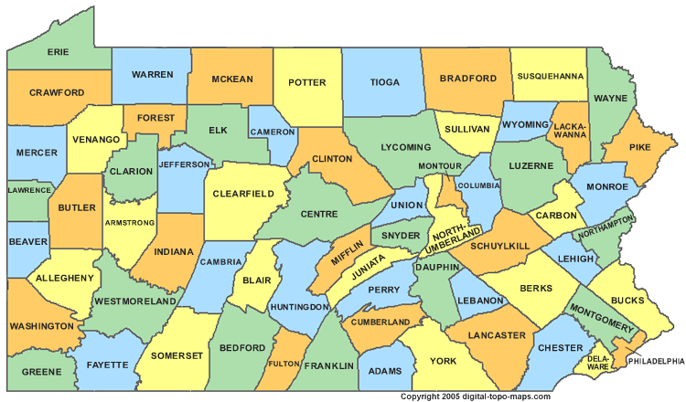
Who conducts my agency’s mock?
Three (3) or four (4) current or former accreditation managers from local police departments
East
Central
West

Slide 68
What is the cost of a mock?
Minimal
Meals
Breakfast
Lunch
Transportation
Extreme circumstance
Hotel
Extreme circumstance

Slide 69
Mock coordination & Reporting
Agency’s Point-of-Contact & Mock Accreditation Team Leader
Team Leader will complete a report (i.e. email, letter, and/or Power DMS report or paper file worksheets and provide this to the agency’s Point-of-Contact and the Pennsylvania Chiefs of Police Association (PCPA) staff

Slide 70
Accreditation Assessment Procedures

Slide 71
What is your plan?

Slide 72
Accreditation Assessment
Accreditation Assessment
Average of one (1) or two (2) day event
Success oriented
Accreditation Team
Two (2) or more Pennsylvania Chiefs of Police Association trained accreditation assessors
Selected from outside of local geographical area

Slide 73
How do I schedule an accreditation assessment (On-site)?
Contact the Andrea Sullivan @ Pennsylvania Chiefs of Police Association
May schedule prior to the mock accreditation assessment; however if this is the case, you may have waited too long to schedule mock!

Slide 74
Scheduling Your agency’s accreditation assessment
60 days prior to on-site in order to ensure time is available to correct any issues that arise from the mock accreditation assessment. In no case would anything less than 30 days be recommended.

Slide 75
How will we ever do this?

Slide 76
Contact & Planning
Accreditation Manager
Contact and discuss with the Team Leader:
Arrival date and time
Daily begin and end times of assessment
Food
Tour of Facility
Static Display
Ride-Along
Interview of the Chief Executive Officer
“Exit” interview
Departure

Slide 77
Professional ethics
Gesture
Coffee Cup
Patch
Pen
Meals
Dinner with the Chief Executive Officer and other members of the Command Staff as well as Accreditation Manager

Slide 78
Prepare employees
Staff
Spotlight agency “stars”
Keep them involved and updated accordingly
Recommend that agency “nay-sayers” are not involved

Slide 79
Demeanor & bearing of Self and agency personnel
Be prepared
Sleep and be well rested
Consistency in appearance
Professionalism

Slide 80
Assessor Workspace
Room
Private
Telephone
Electrical outlets
Extension cords
Internet access
Supplies
Paper
Pens

Slide 81
Assessor Workspace
Resources
Annual Report
Organizational Chart
Crimes Code
Collective Bargaining Agreement

Slide 82
Reasonable access to the accreditation manager
Assessor Workspace

Slide 83
Hospitality

Slide 84
Conflict Resolution
Early resolution is imperative
Team Leader -> Accreditation Manager
Team Leader -> Chief Executive Officer
Team Leader -> Accreditation Coordinator for PCPA

Slide 85
Compliance verification
Facility Tour
Static Display
Interviews
File Review
Paper
Power DMS

Slide 86
The day of your agency’s Accreditation Assessment

Slide 87
Day 1 and/or 2
Escort to agency
Introductions to Stakeholders
Facility Tour
Static Display
Interviews
File Review
Ride-Along

Slide 88
Re-Accreditation Assessments = 1 or 2 Day

Slide 89
Observations
Facility Tour
Cells (If Applicable)
Communications Center (If Applicable)
Evidence
Temporary
Storage
Impound
Temporary Holding
Static Display
Lethal and Less Lethal Weapons
Specialty Units
Equipment
K-9
Mounted
Specialty Vehicles
ATV
Bicycles
Boat
Motorcycles

Slide 90
Tour Sheet
Customized specific to your agency
Organized to the layout of your agency’s facility

Slide 91
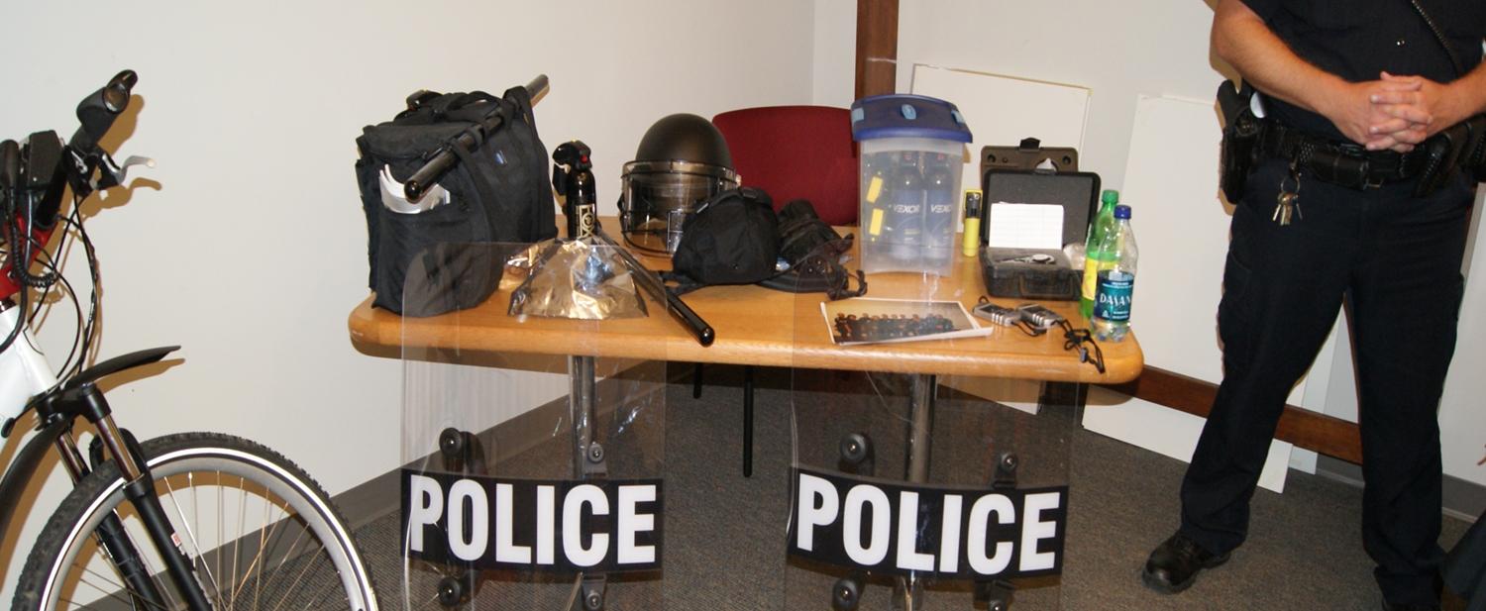
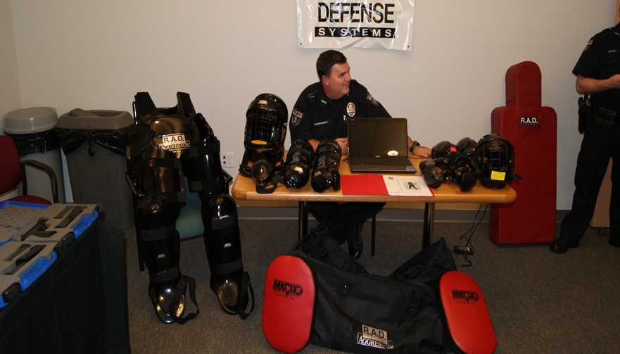
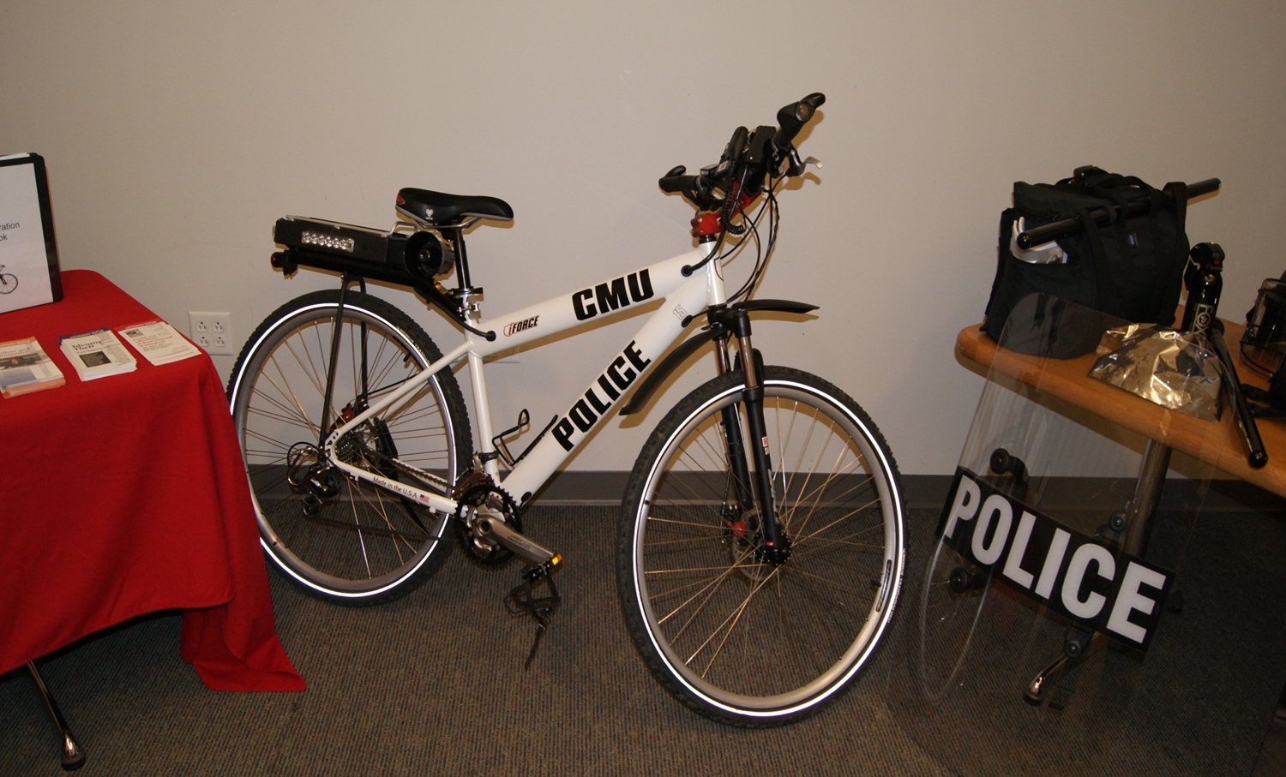

Slide 92
“Exit” Interview
Audience
Determined by the Chief Executive Officer
Each assessor discusses points of interest or concerns
Team Leader discusses adjustments or recommendations
Will not confirm “Pass/Fail”

Slide 93
Recommendations
Accreditation
Provisional Accreditation
No
Neutral

Slide 94
Accreditation Requirements
Valid for 36-months
Awarded by the Pennsylvania Chiefs of Police Association
Re-assessment required to maintain status
Annual Compliance Survey

Slide 95
Pennsylvania Chiefs of police association
Richard Hammon
Accreditation Program Coordinator
rhammon@pachiefs.org
Andrea Sullivan
Accreditation Administrative Assistant
asullivan@pachiefs.org
www.pachiefs.org

Slide 96
Questions

