Slide 1

Pennsylvania Chiefs of Police association

Slide 2

The Pennsylvania
Law Enforcement Accreditation Program
Power DMS Training

Slide 3


Slide 4

Audience
Individuals who are:
  Prospective Accreditation Manager
  New Accreditation Managers
  Veteran Accreditation Managers

Slide 5
Focus Areas
Power DMS
  What is Power DMS?
  How could my agency utilize Power DMS?
  What training can members of my agency receive on how to utilize Power DMS?
  How do I utilize Power DMS for accreditation purposes?
  How does my agency acquire Power DMS?

Slide 6

Why are you here?
To become familiar with:
  Power DMS
    Suite - Cost varies according to agency size
      Documents
      Certificates
      Courses
      Tests
      Surveys
    Accreditation module – Cost is $750.00 per year

Slide 7
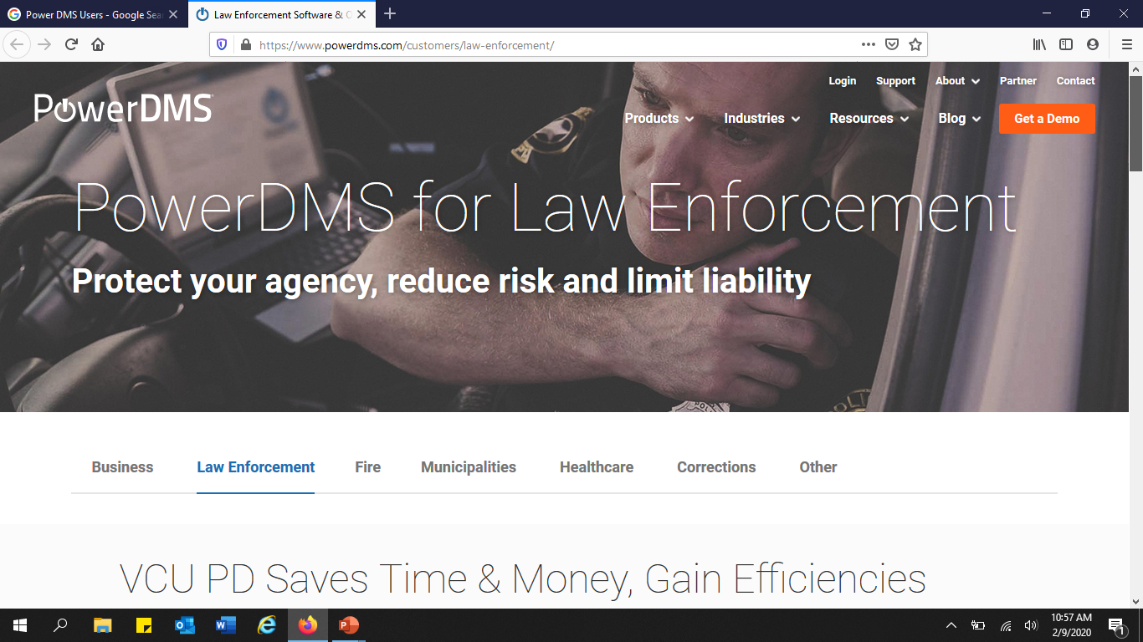

Slide 8
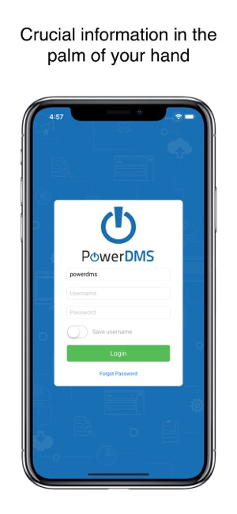
An Introduction to Power DMS

Slide 9

What is Power DMS?
Document Management
  Reduce risk
  Liability
  Cost
www.powerdms.com
  Trial offer
  Webinars
    Training

Slide 10
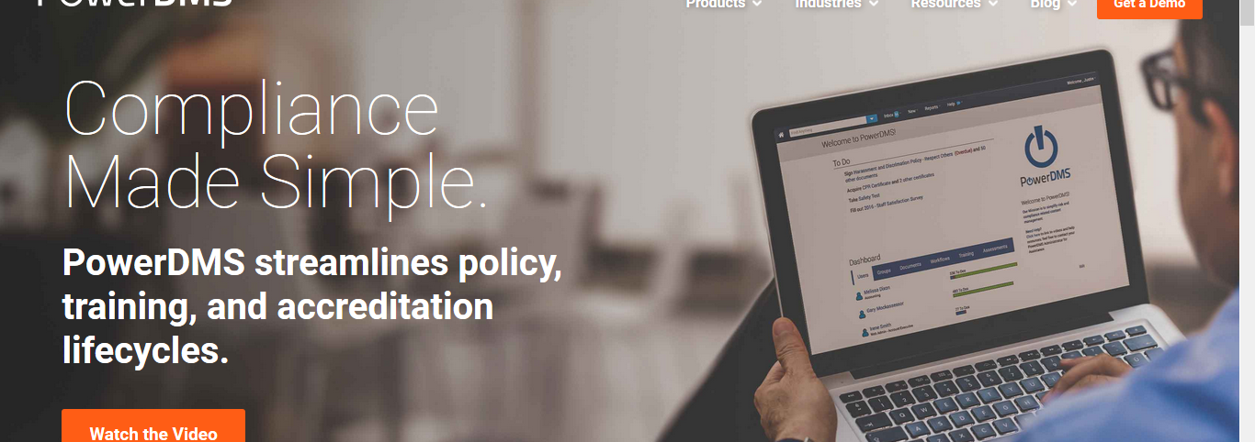
What benefits will power dms provide to my agency?

Slide 11

Central location that allows for:
  Accreditation
  Audit trail
  Document control
  Policy management
  Training
  Version control
  Workflows

Slide 12
What are the Capabilities of Power DMS?
Workflow
Author
Collaborative
Approve
Publish
Training
Develop
Customize
Accreditation
Standards
PLEAC
CALEA
Policy
Proofs of Compliance

Slide 13

Accessing Power DMS
Site Key
  Agency specific

Slide 14
Navigating Power DMS
Homepage
“To Do”
Dashboard
Toolbar
“Find Anything”
Inbox
New
Reports
Help
“Welcome”
“Rights”
User
Administrative

Slide 15
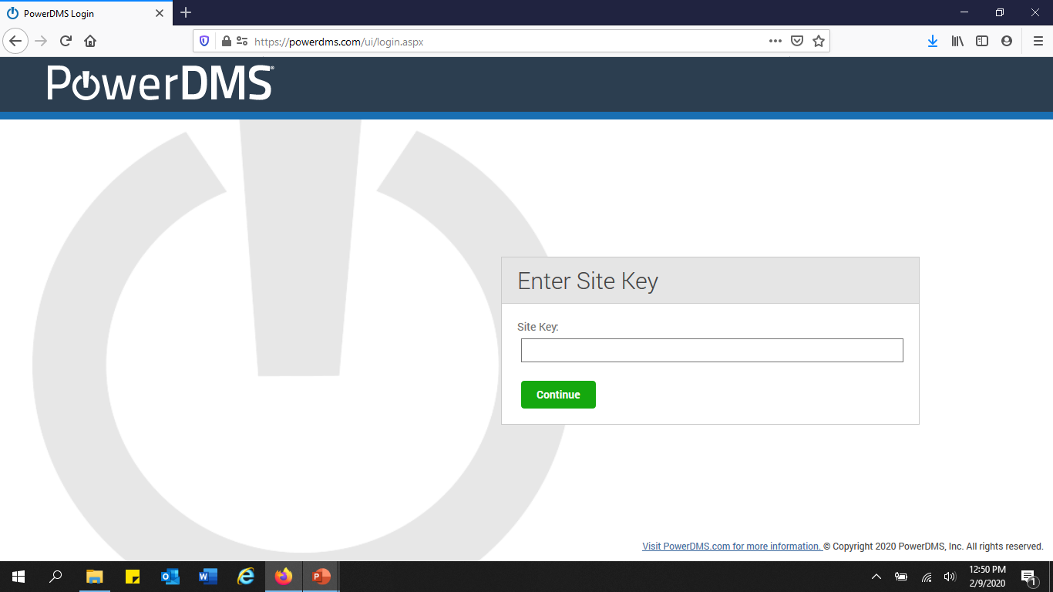

Slide 16
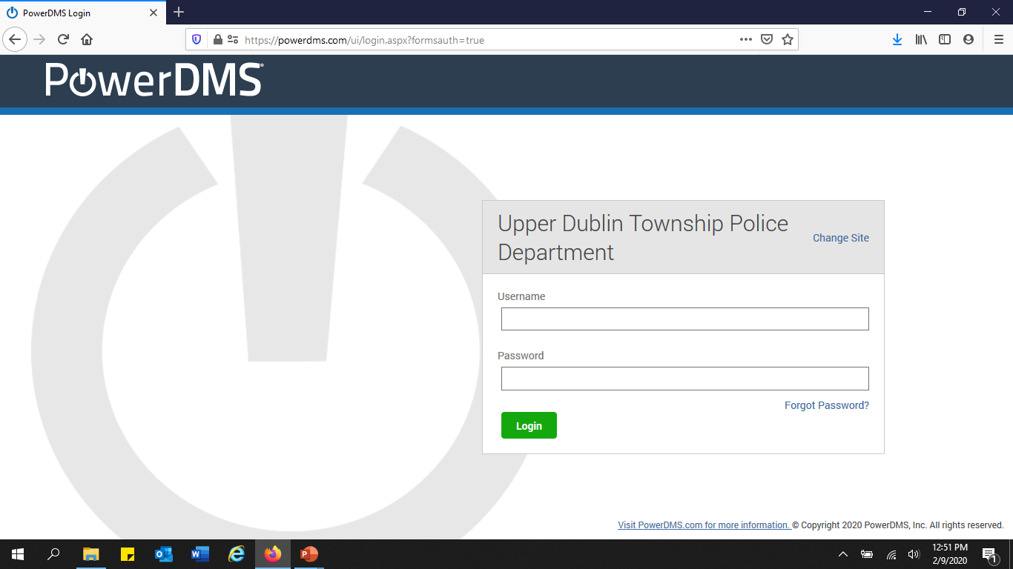

Slide 17
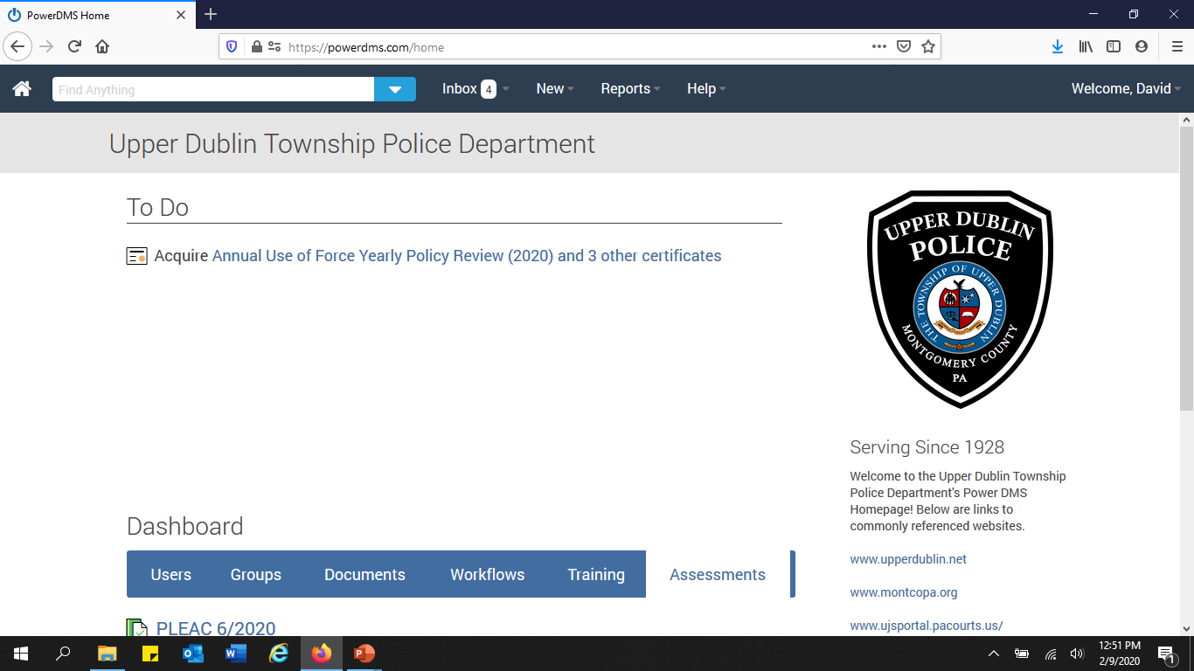

Slide 18
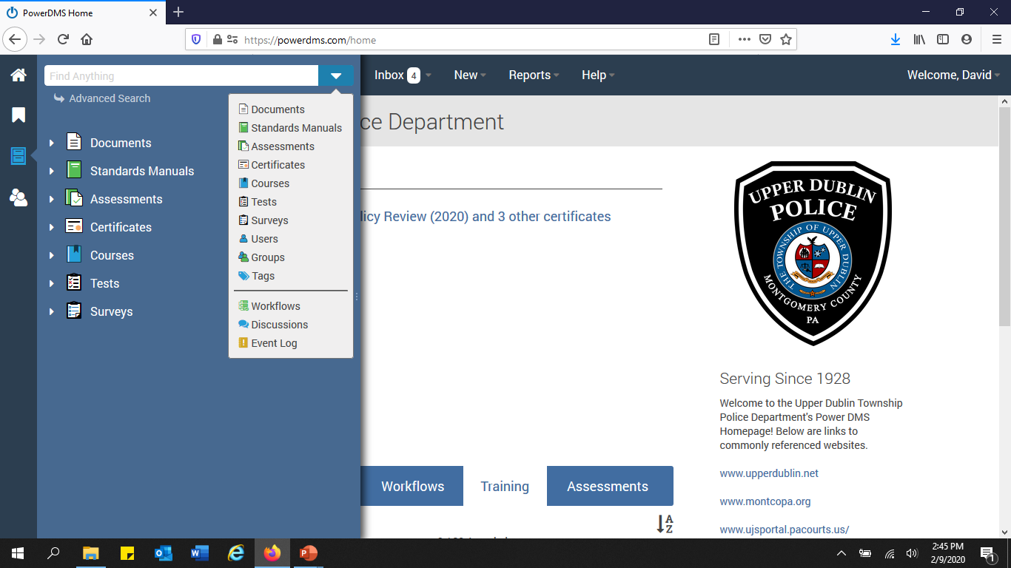

Slide 19
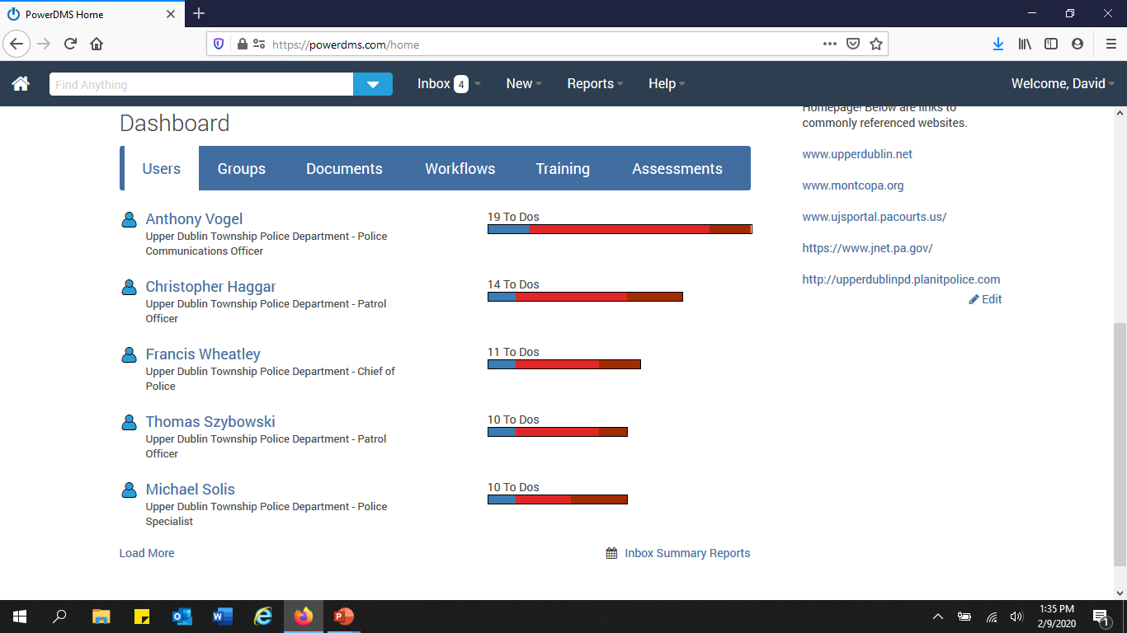

Slide 20
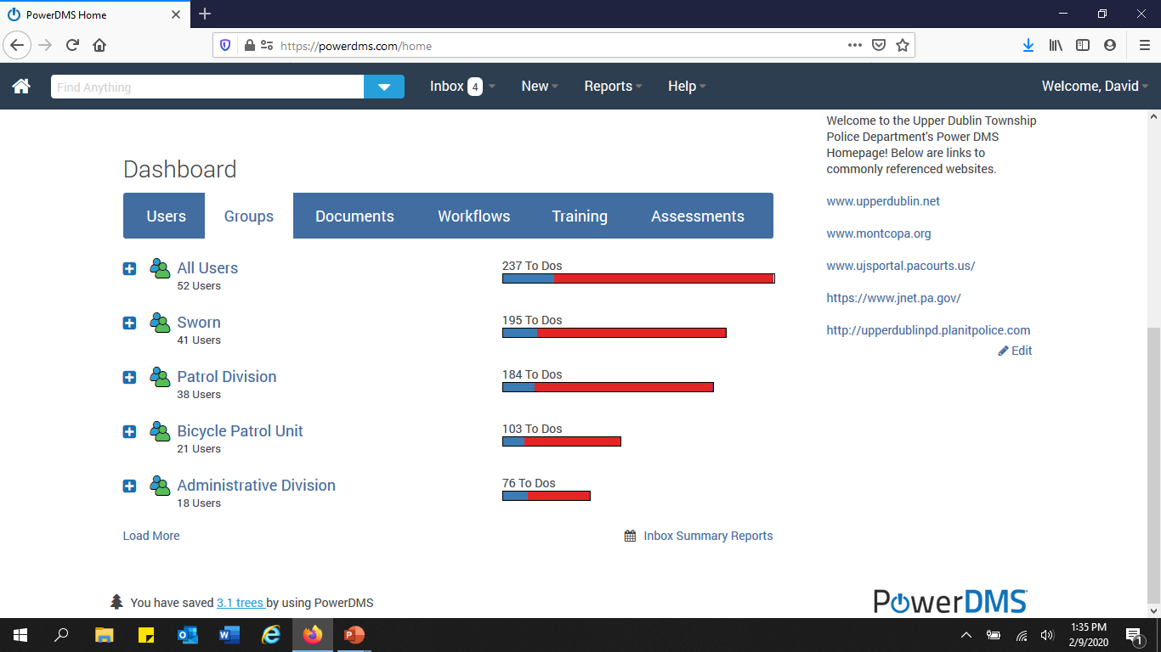

Slide 21
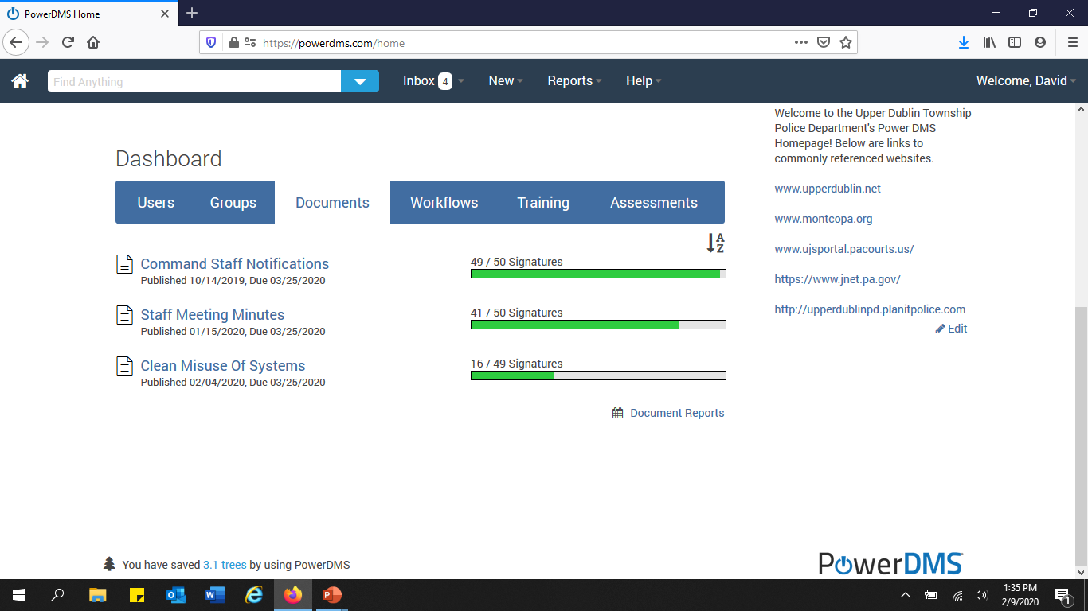

Slide 22
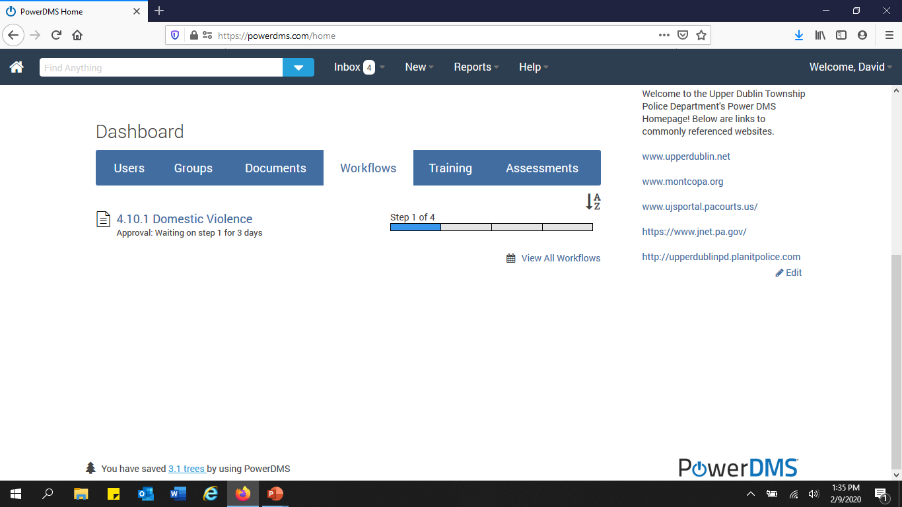

Slide 23
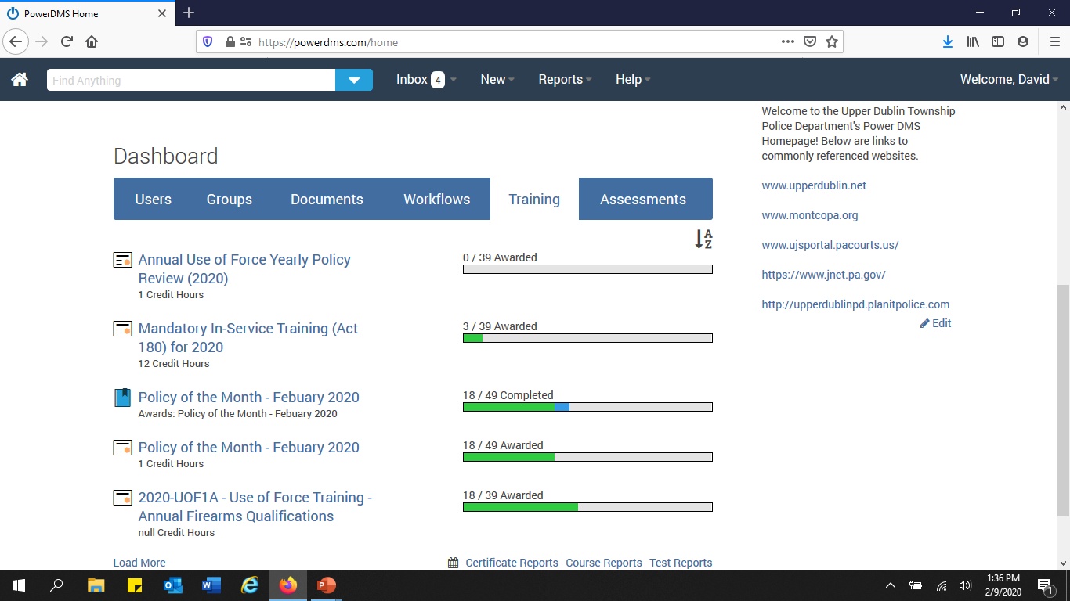

Slide 24
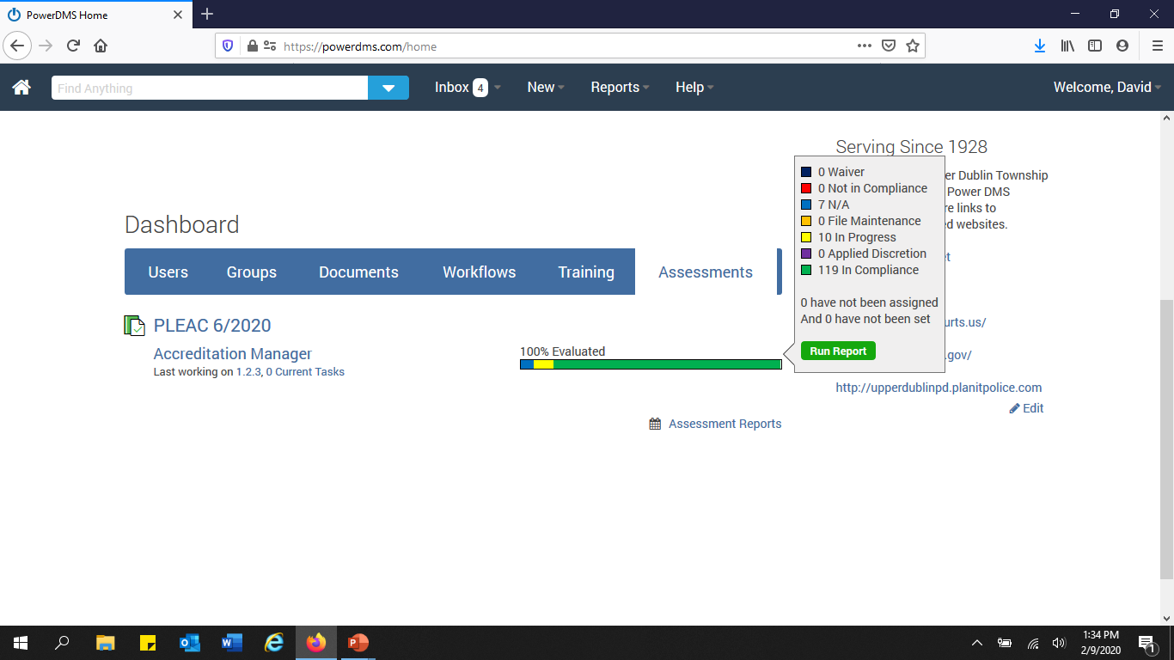

Slide 25
Messages & Documents
Messages
Internal
Users
External
Automated to user email address
Documents
Policies
Forms
Miscellaneous

Slide 26
Courses & Certificates
Courses
PowerPoints
Certificates
Record of Training
Internal
External

Slide 27
Tests & Surveys
Tests
Multiple Choice
Fill-in-the-Blank
True & False
Surveys

Slide 28


Standards
Accreditation Assessment

Slide 29
Miscellaneous
Users
Employees
Sworn
Non-sworn
Groups
Field Training Officers
Bicycle Patrol Officers
Use of Force Trainers
Discussion
Documents
Event Log
Activity

Slide 30
Organizing
Users
Power DMS recommends assigning group roles, even if only one user in the group; Organize from the “bottom up.”
Permissions
Assign permissions by group instead of individual.
If someone leaves a group (assignment) it is easier to add the new person to a group instead of trying to assign permissions from scratch.

Slide 31
Workflows
Approve or Deny
  Example:
    “Staff Approval”
        (Professional Standards Officer)
      Deputy Chief of Police & Lieutenant
        (Professional Standards Officer)
      Chief of Police
        (Professional Standards Officer)

Slide 32
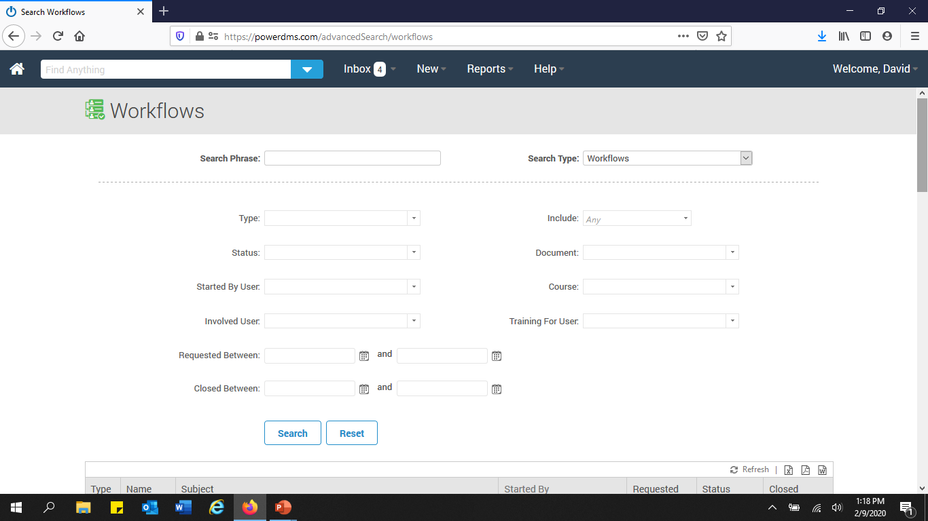

Slide 33
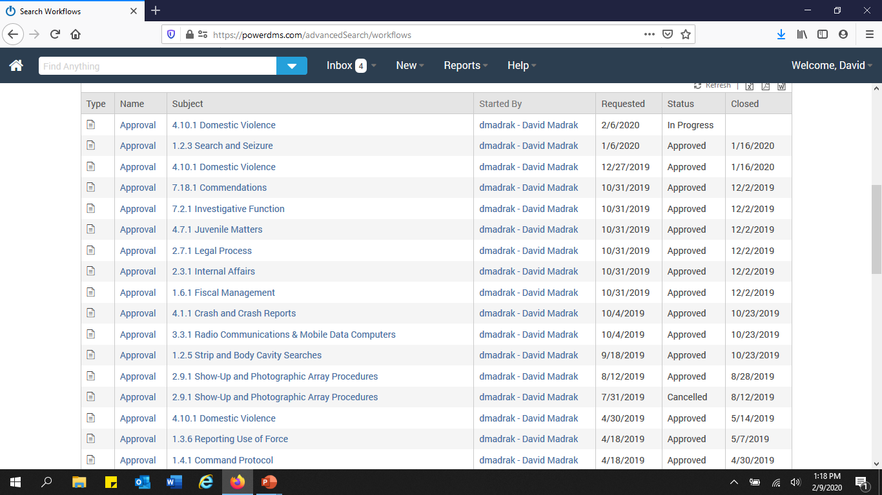

Slide 34
Reports
Documents
Certificates
Courses
Standards
Tests
Surveys
Users

Slide 35


Slide 36
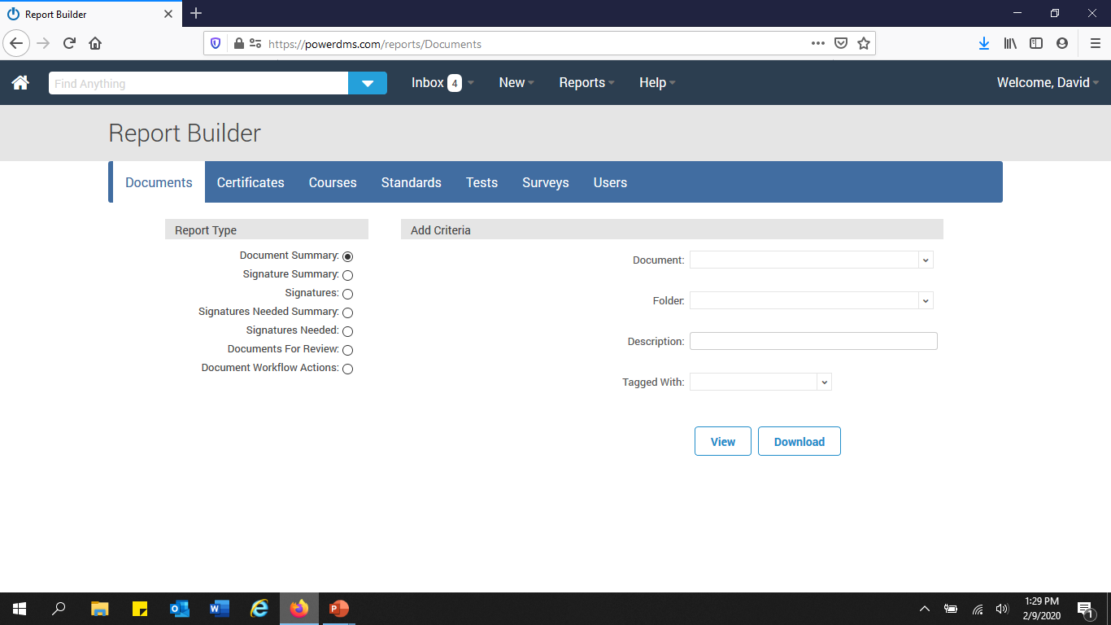

Slide 37
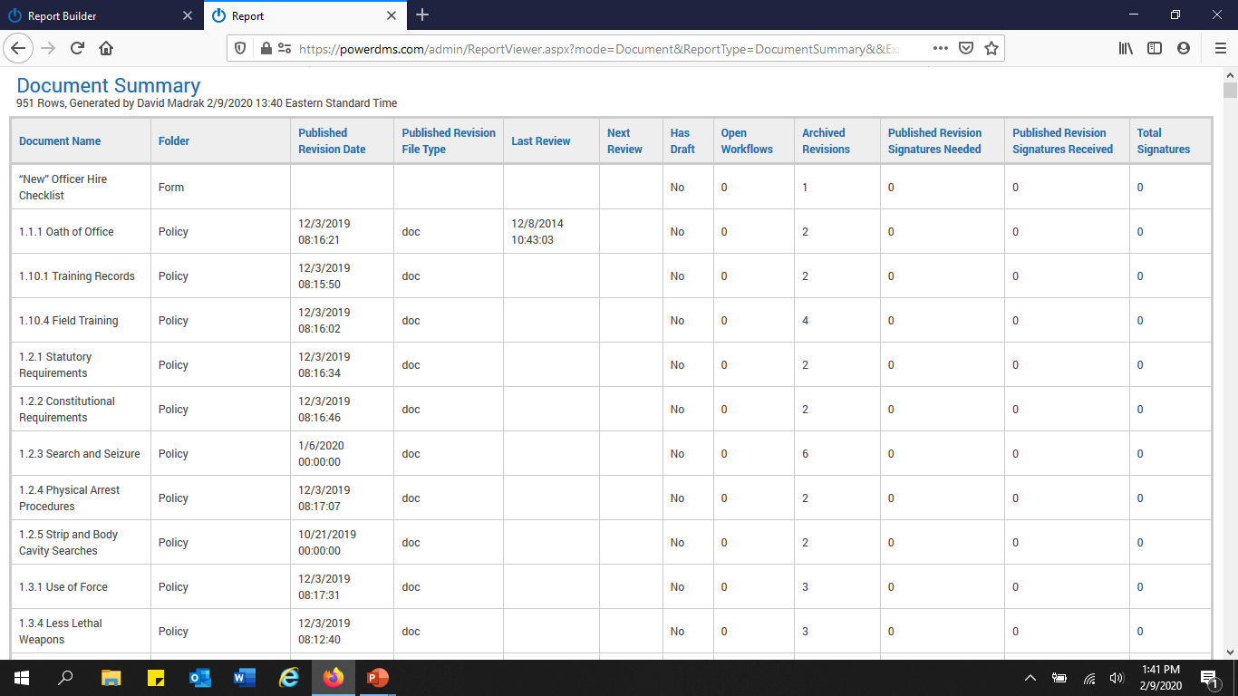

Slide 38
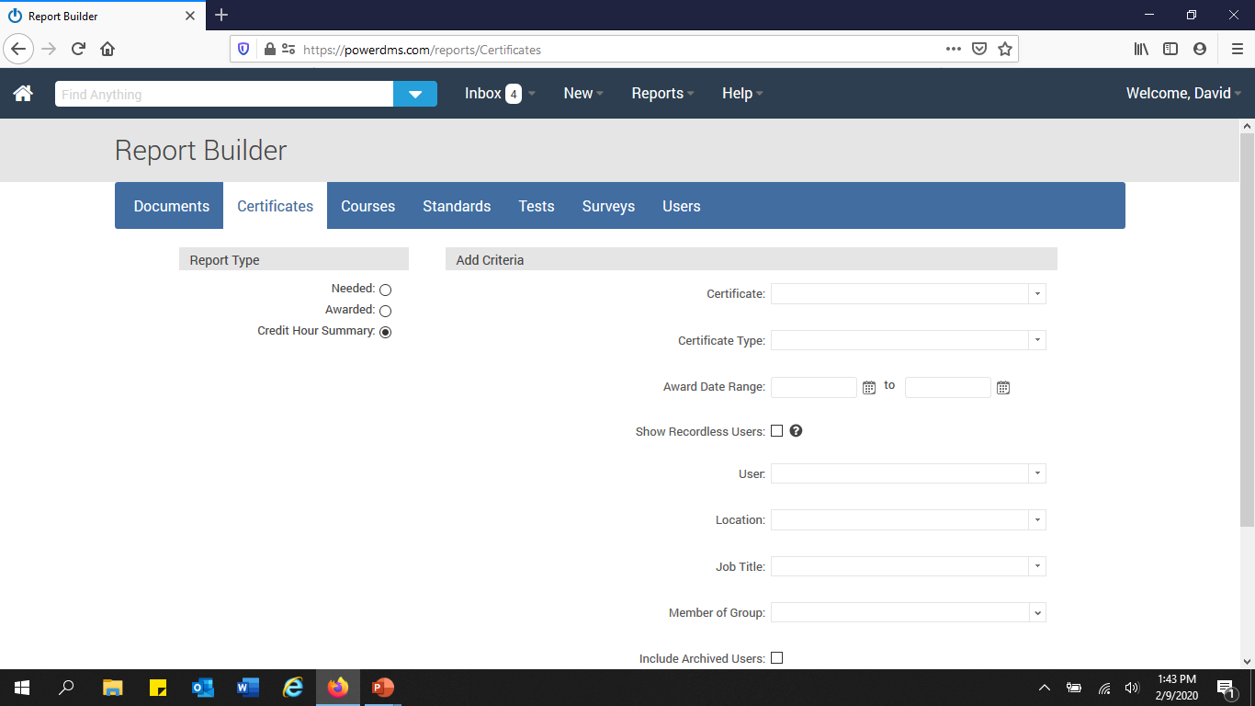

Slide 39
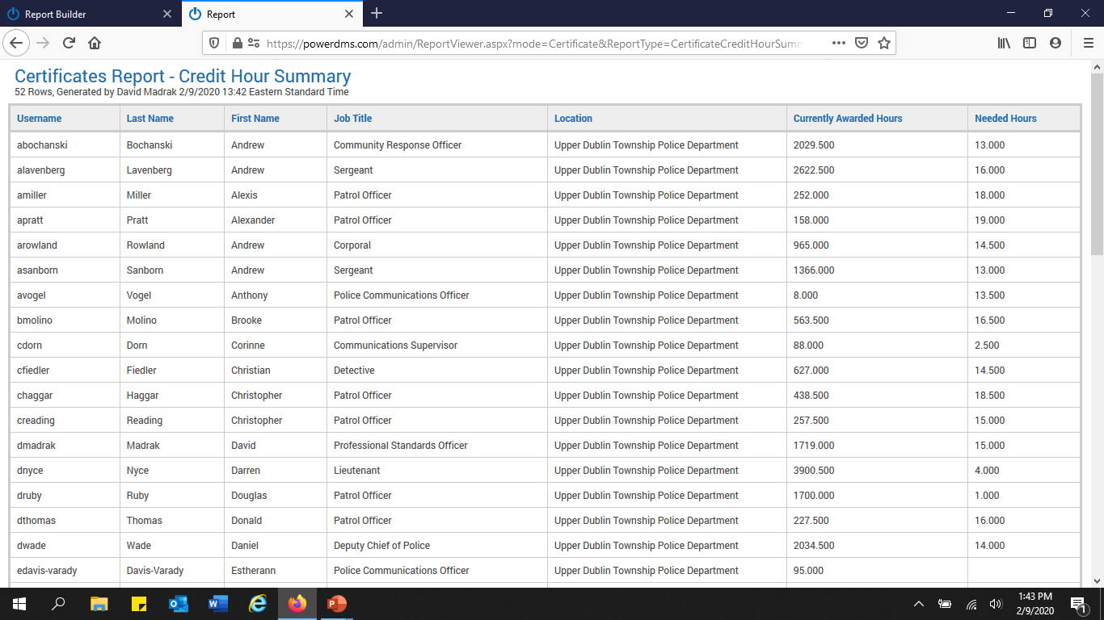

Slide 40
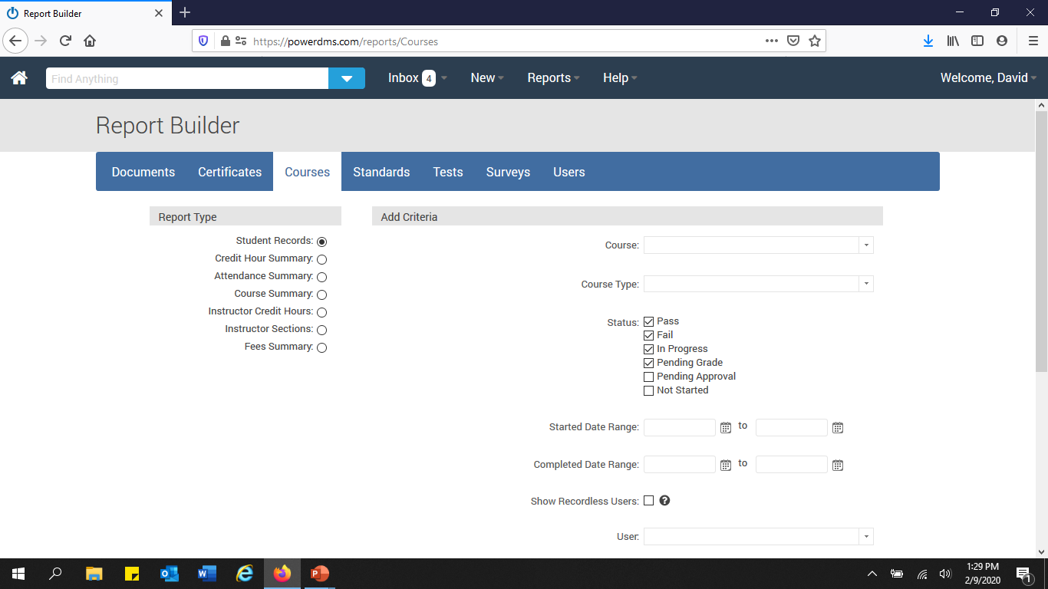

Slide 41
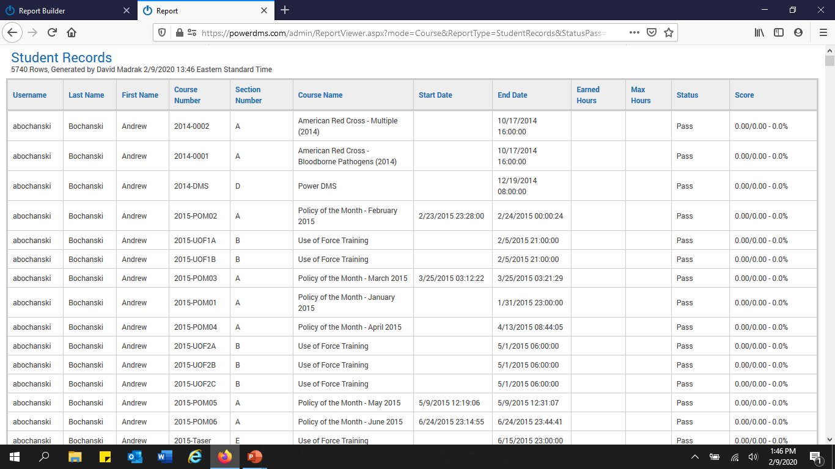

Slide 42
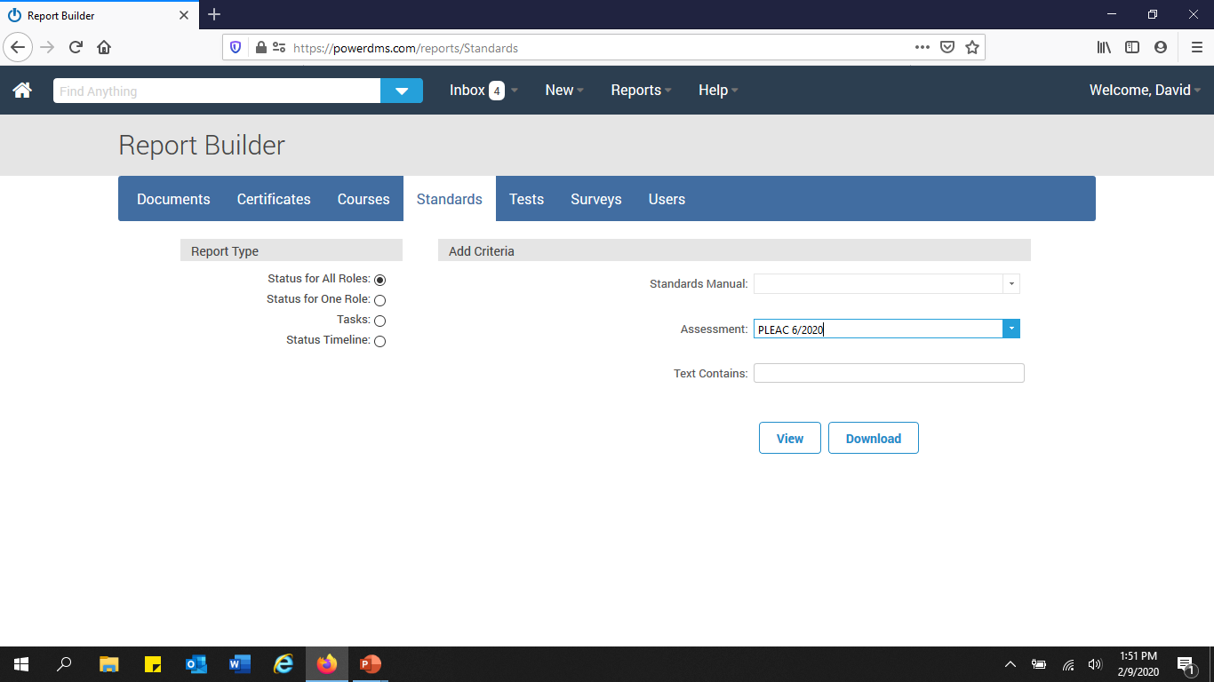

Slide 43
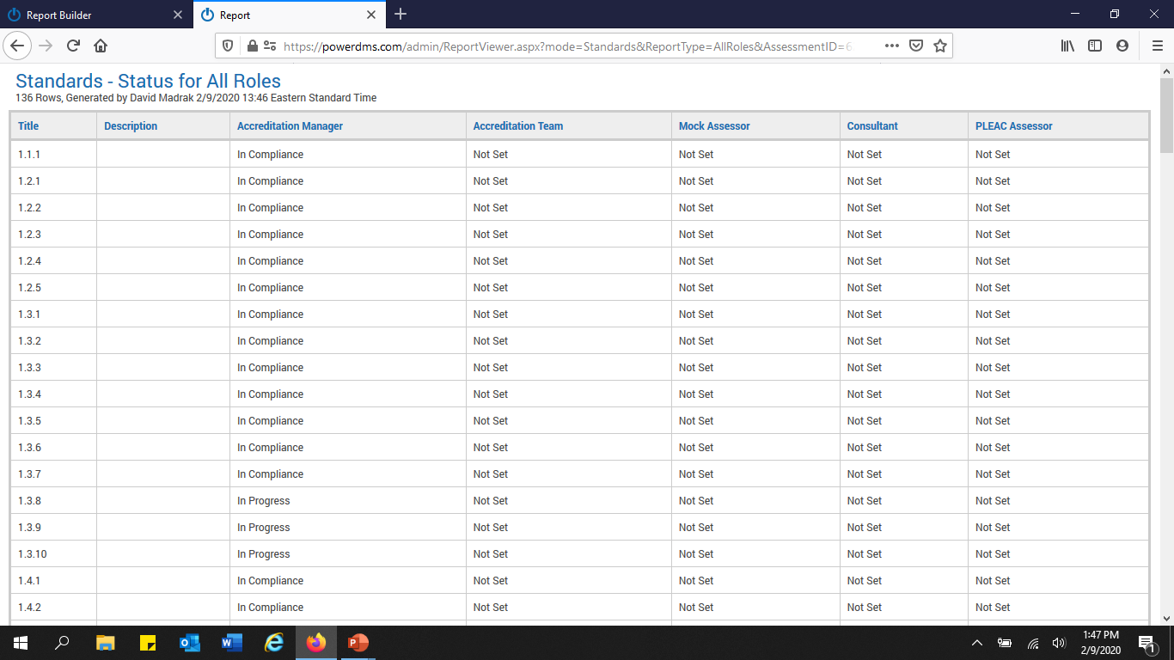

Slide 44
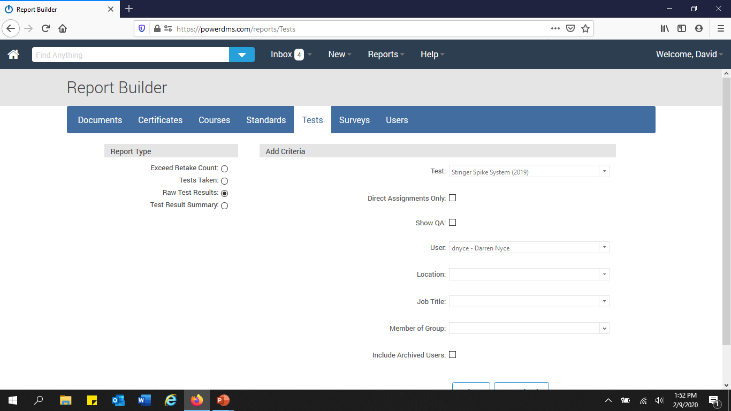

Slide 45
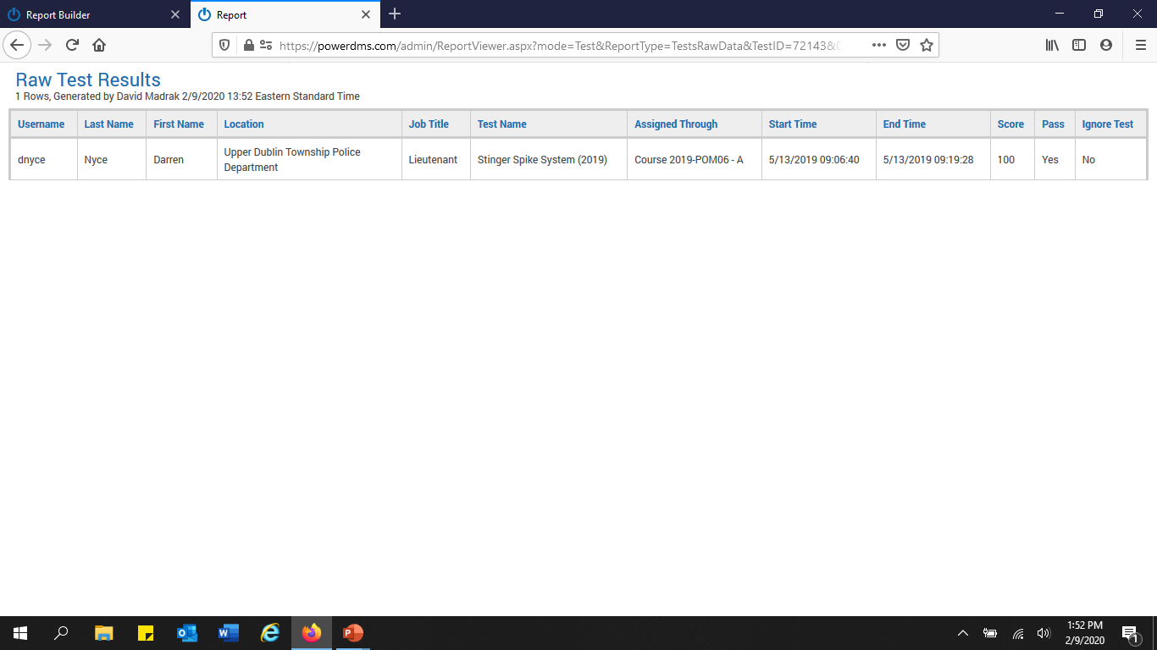

Slide 46
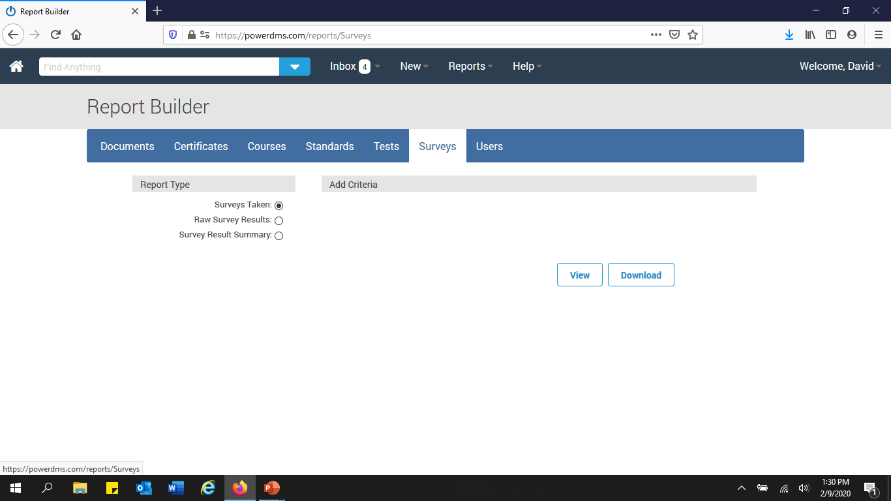

Slide 47
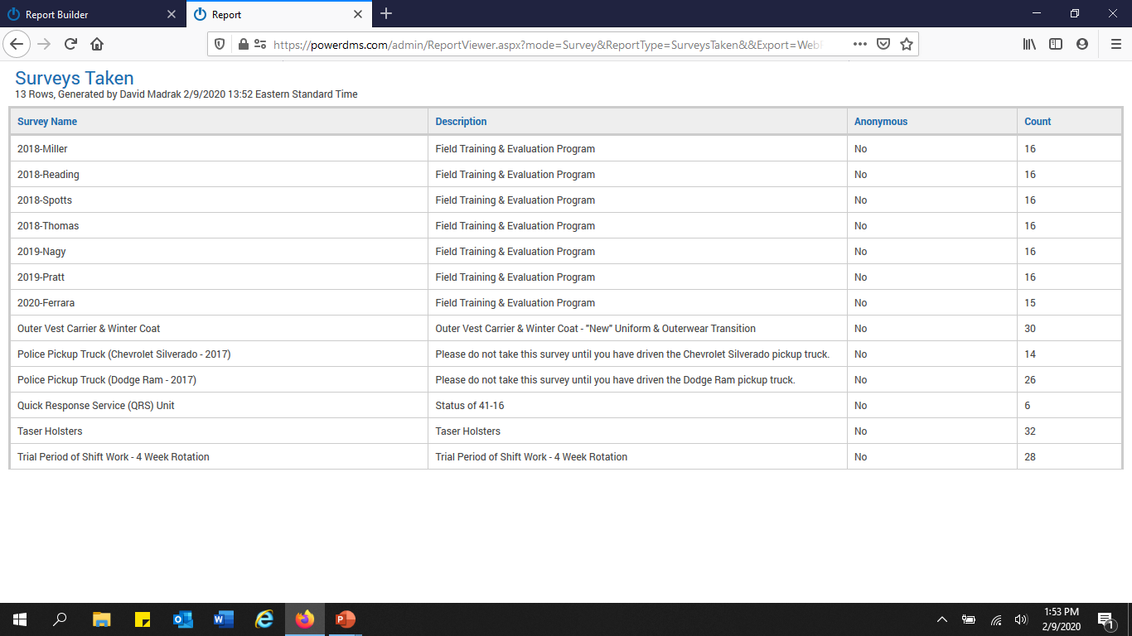

Slide 48
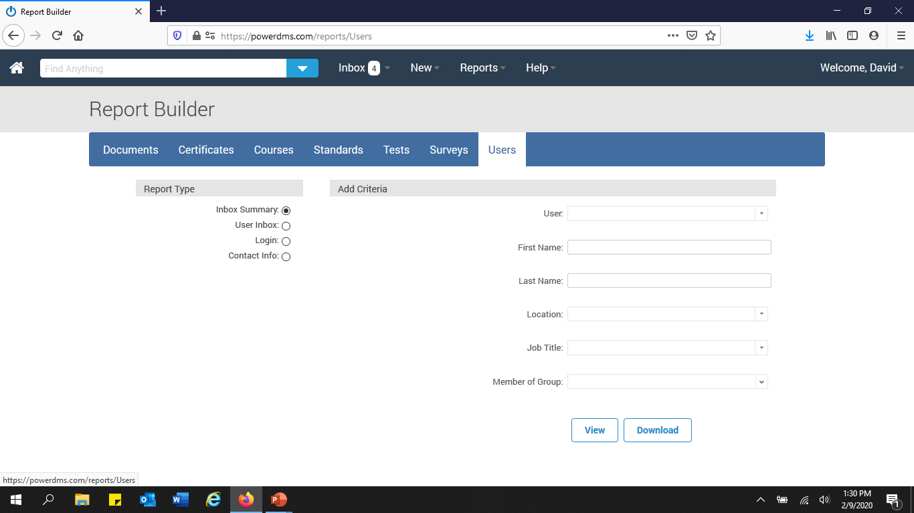

Slide 49
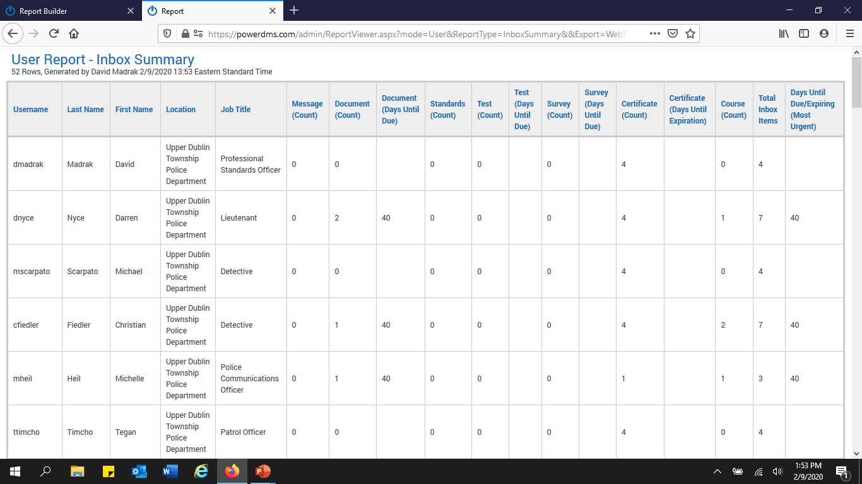

Slide 50


Slide 51
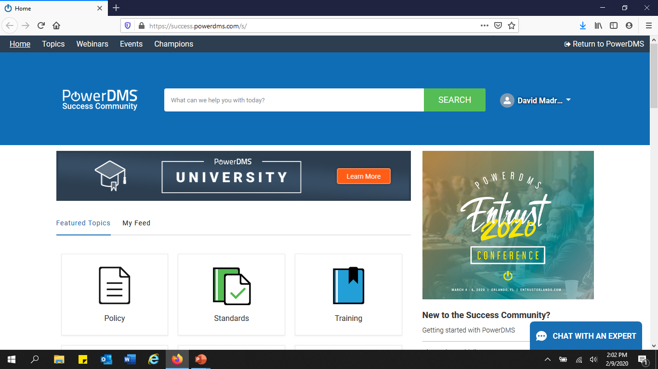

Slide 52
Power DMS & the Pennsylvania Accreditation program

Slide 53

Access to Standards Manual
Select the appropriate manual
  PLEAC
  CALEA
Request Access
Access granted

Slide 54
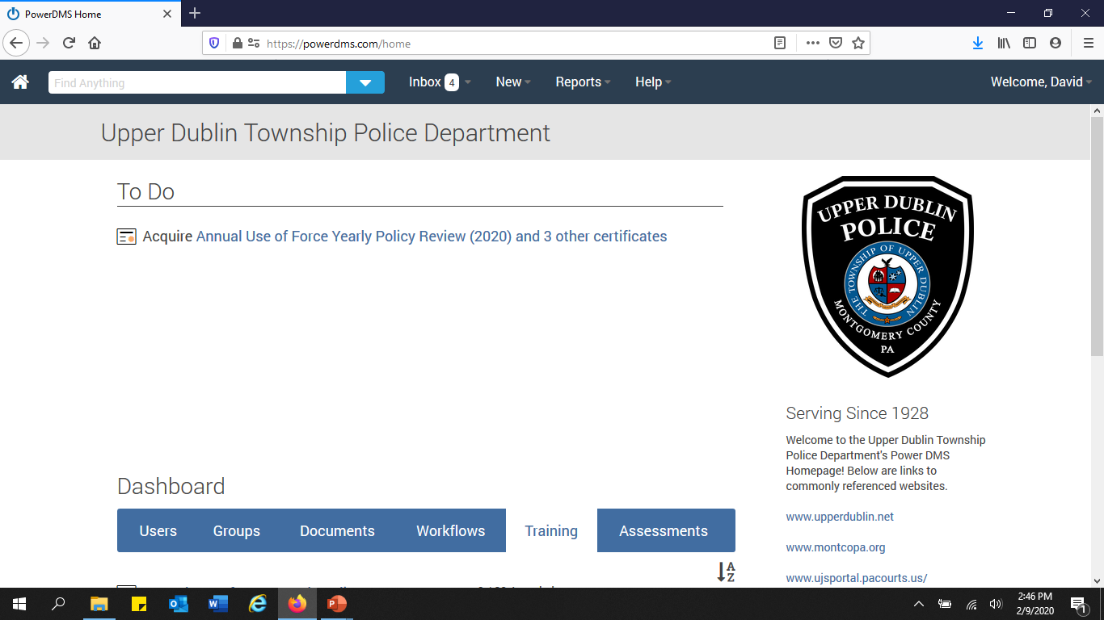

Slide 55
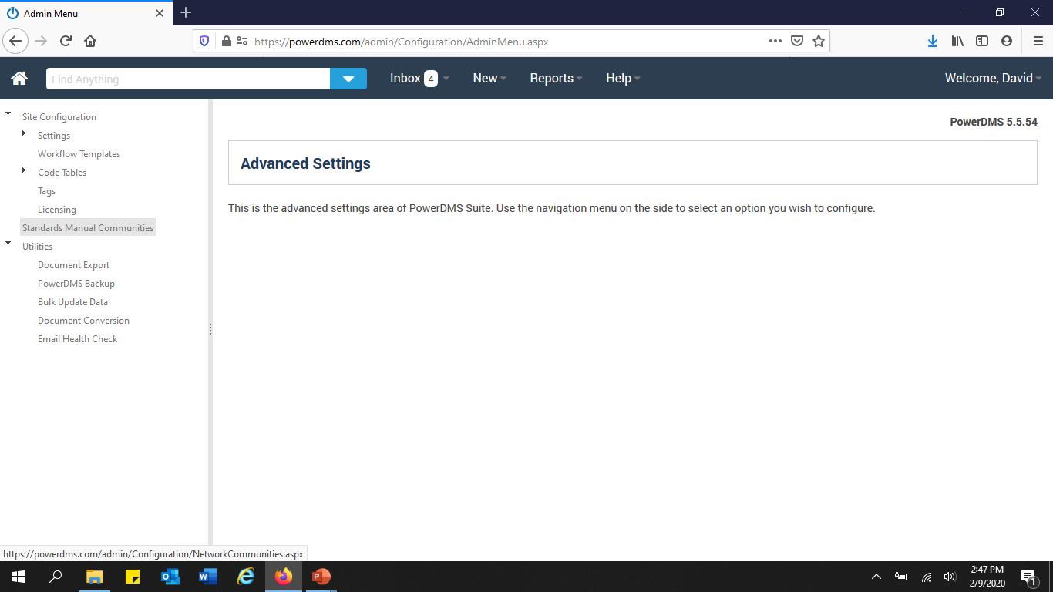

Slide 56
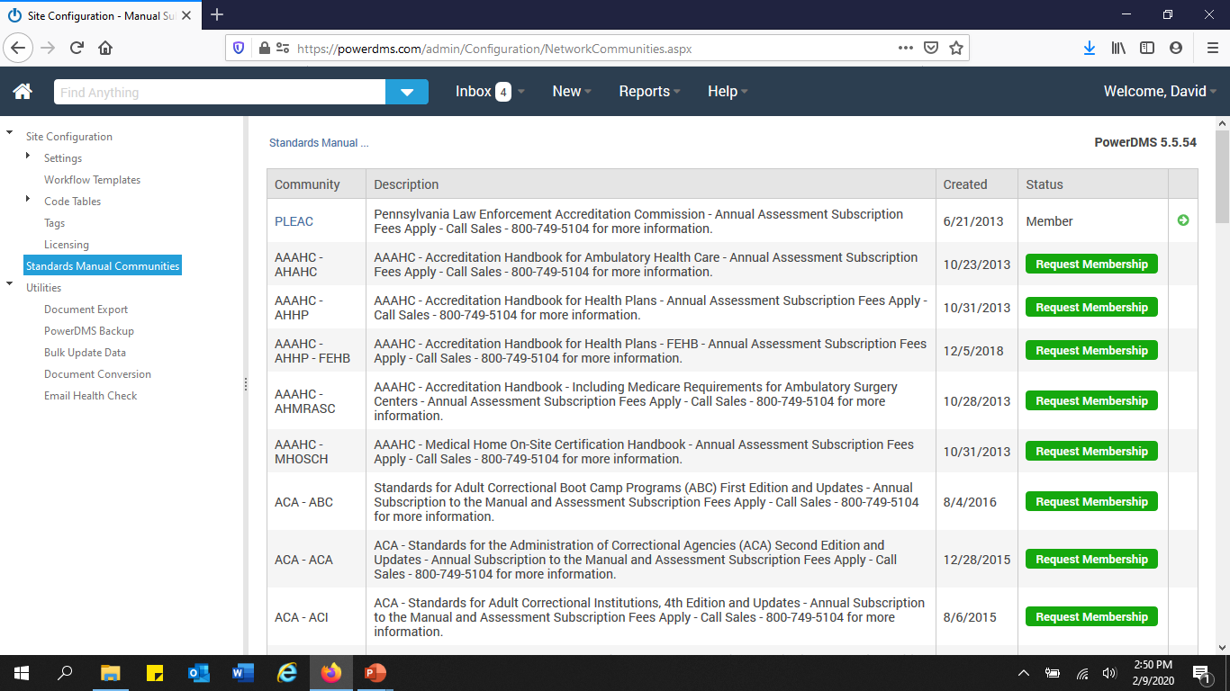

Slide 57
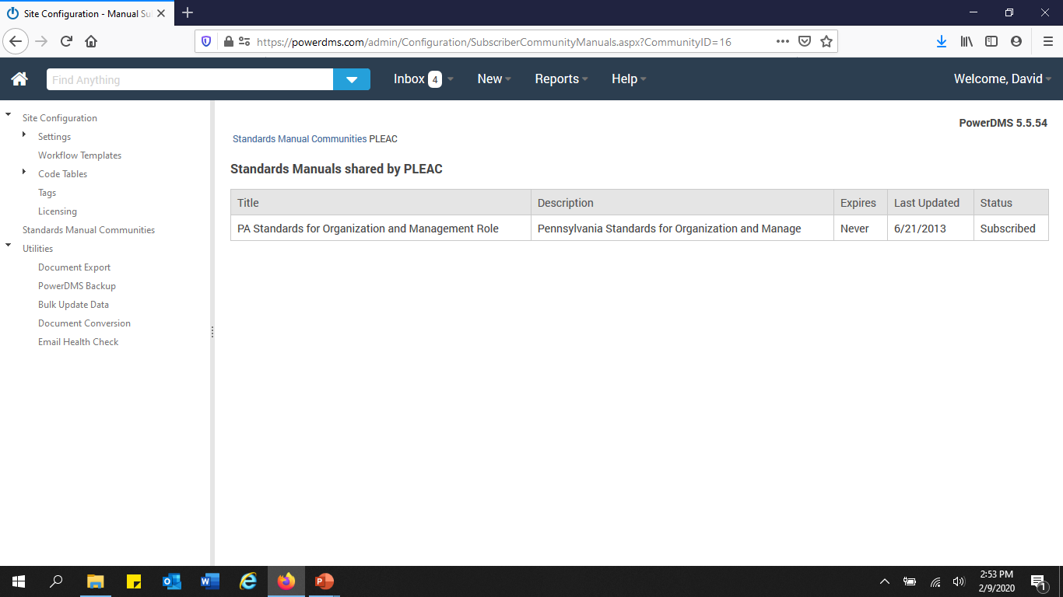

Slide 58

Standards Manual
Most recent version of the PLEAC Standards Manual
Will be the Standards Manual from which your assessment will be derived.

Slide 59
Creating an Assessment
Naming
  Agencies seeking to become accredited
    Twelve (12) months from expected accreditation assessment date
      PLEAC 6/2021
  Agencies seeking re-accreditation
    Three (3) Years from previous Accreditation Assessment
      PLEAC 6/2020

Slide 60
Creating an Assessment
Role (Presumably)
  Accreditation Manager
“Save”

Slide 61
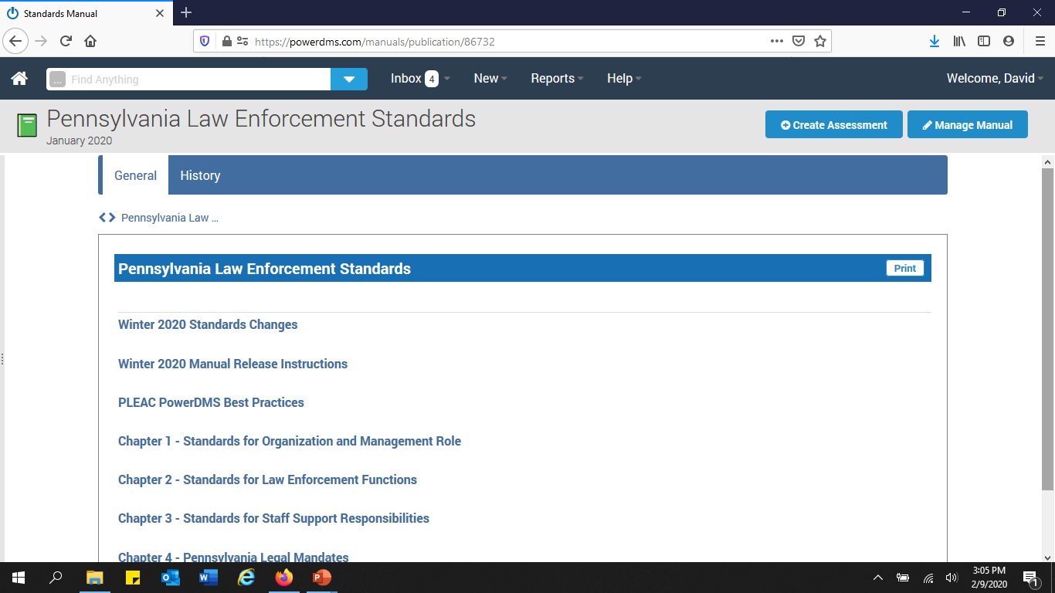

Slide 62
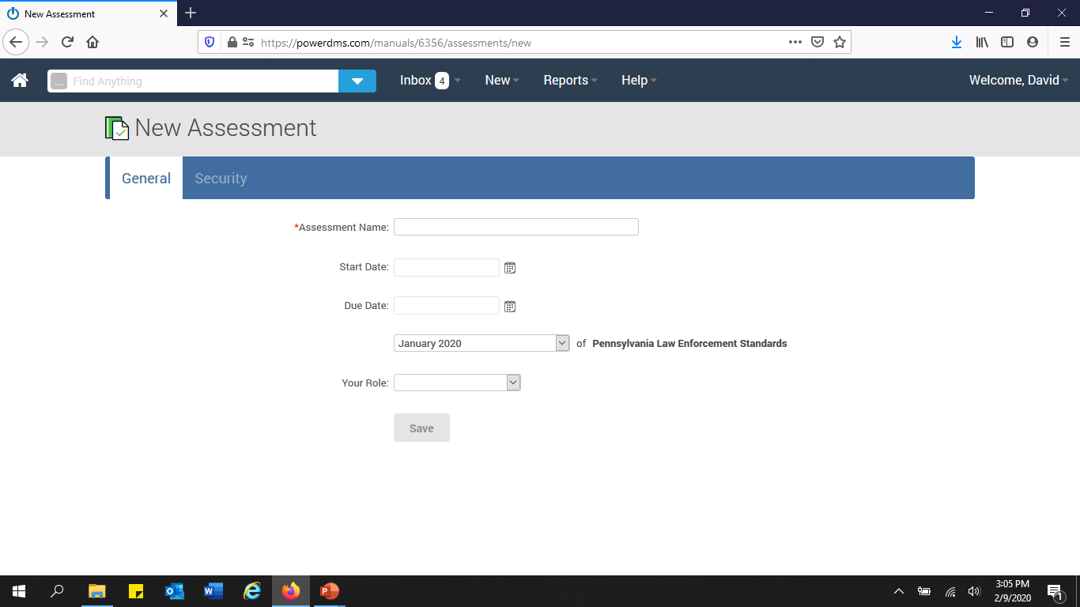

Slide 63
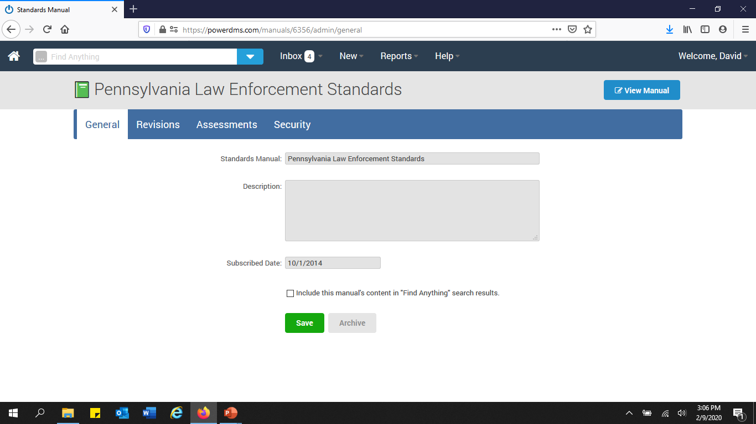

Slide 64
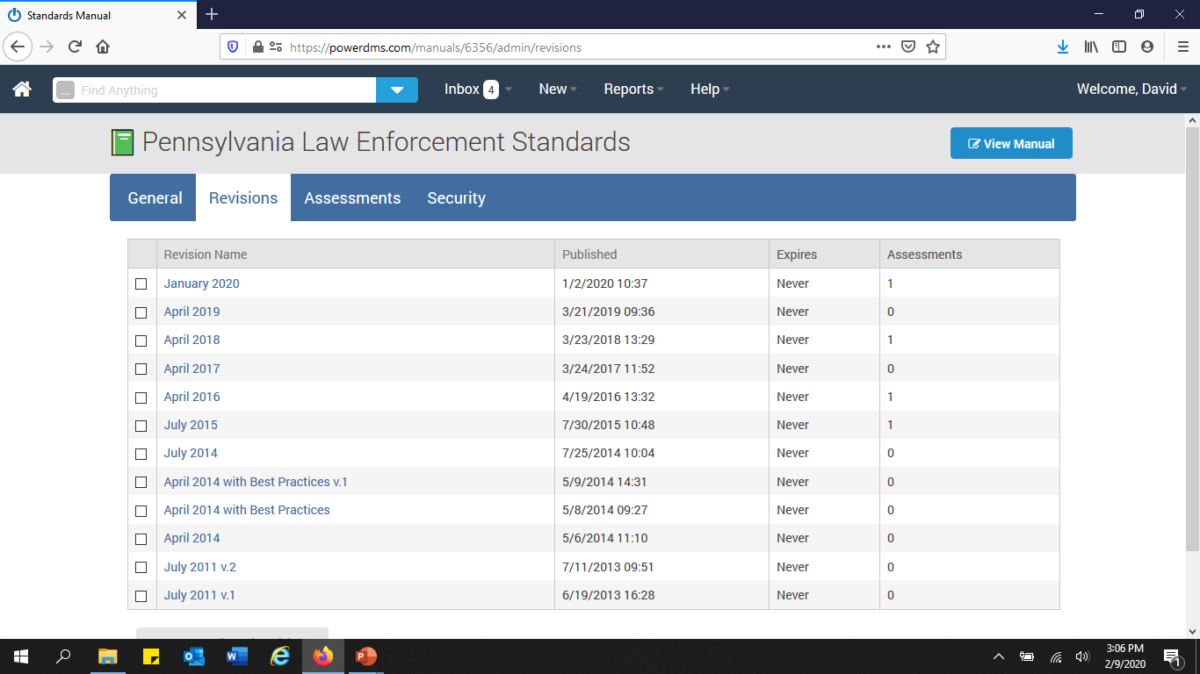

Slide 65
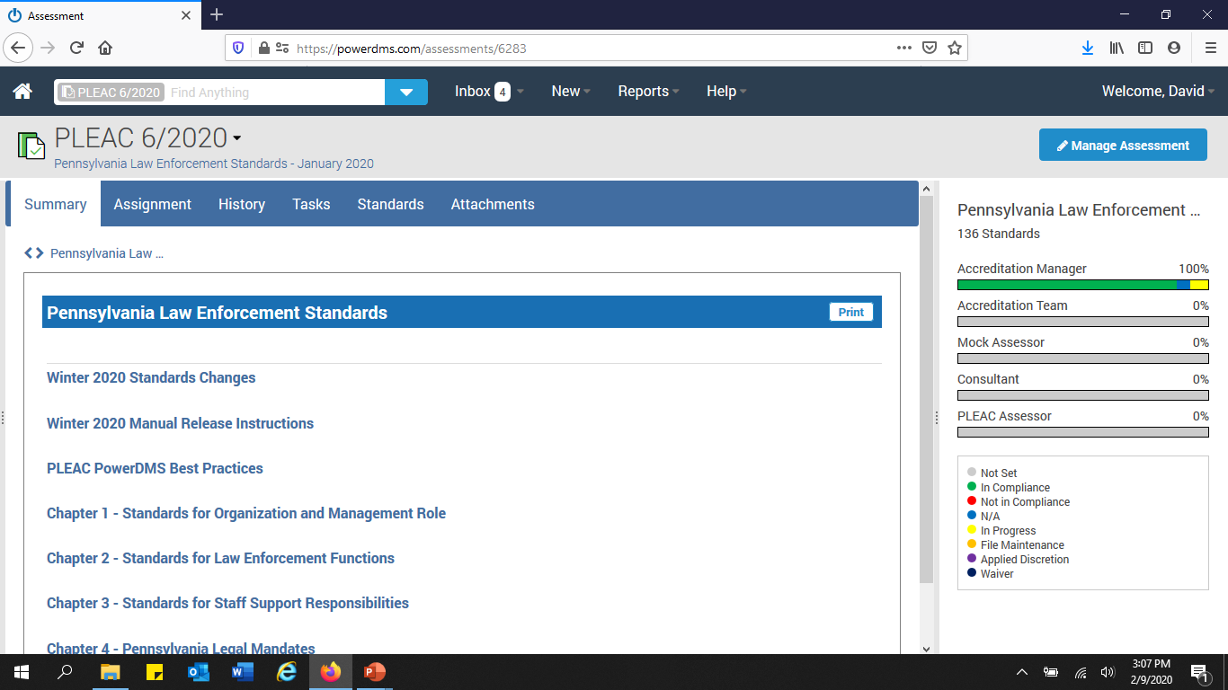

Slide 66


Slide 67
Security
Levels
  Ensure that all personnel who will be involved in the accreditation assessment are provided with the proper access
    View
    Audit
    Edit (i.e. add or delete documents, etc.)
  Make sure that “Add” and “Save” are both selected

Slide 68
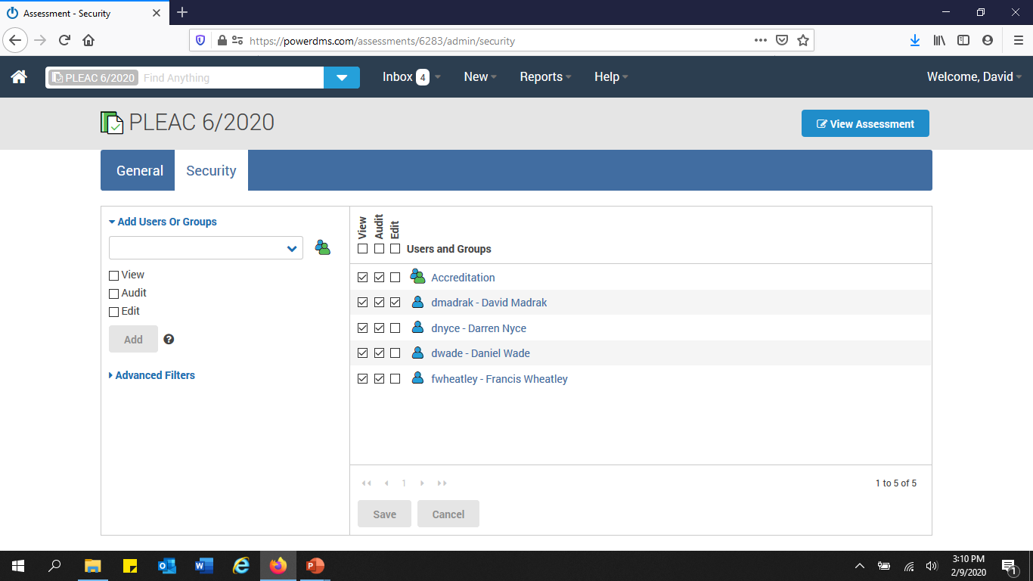

Slide 69

Groups
“Home”
  Select “New” Group
  Create
    Select “Members”
      Select the members names that will be part of the Accreditation group

Slide 70
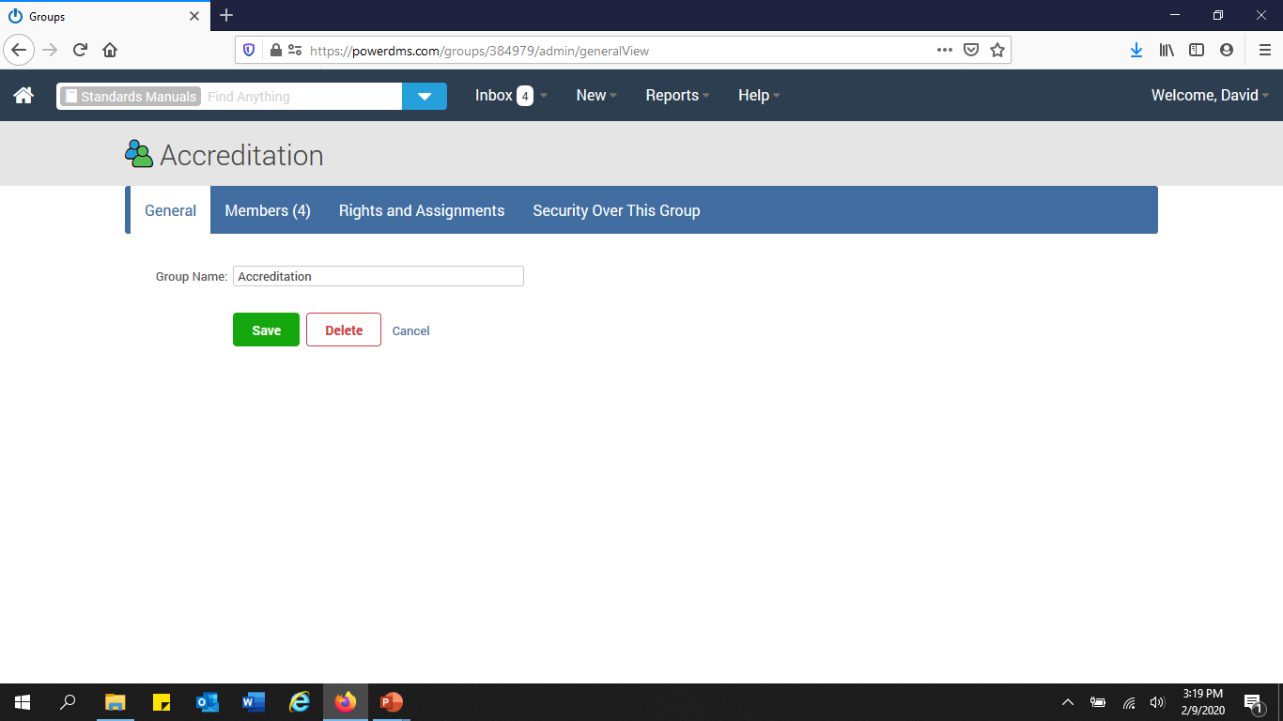

Slide 71
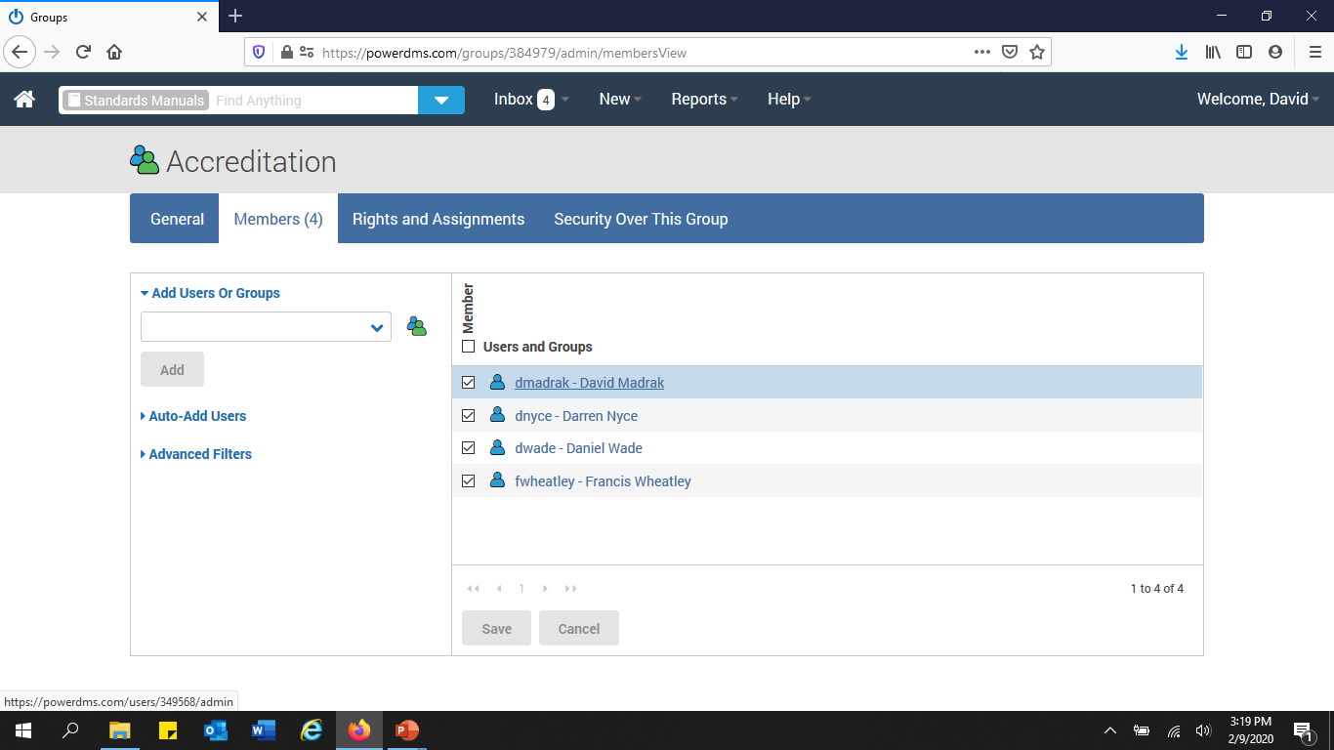

Slide 72
Assignment
Assessment
  Select “Assignment”
    Name
    Role
      Accreditation Manager
      Accreditation Team
      Consultant
      Mock Assessor
      PLEAC Assessor
    Responsibility
      Participate
      Observe

Slide 73
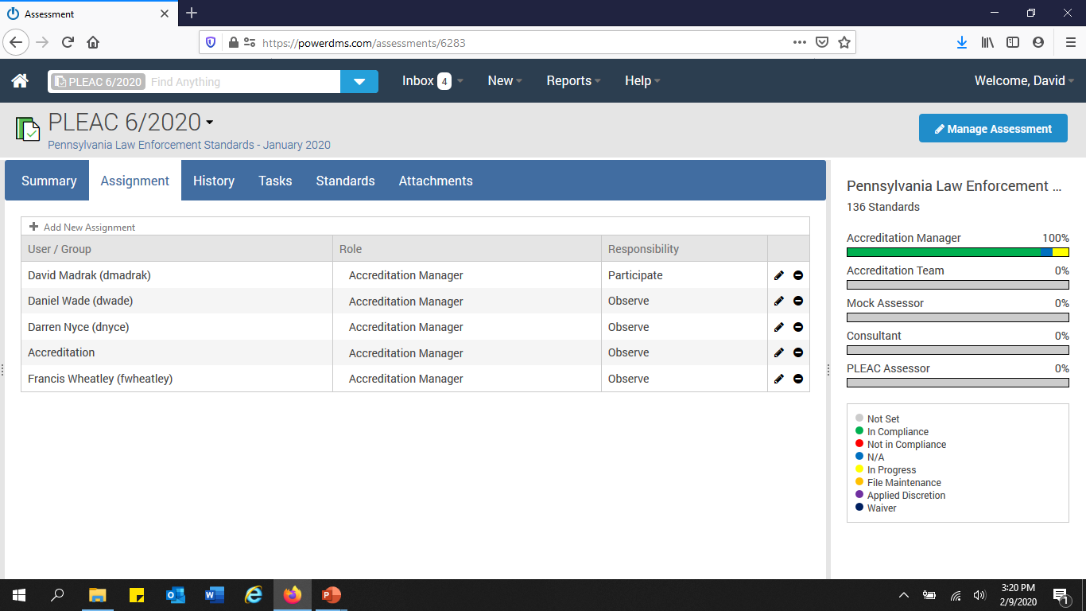

Slide 74

What! I have how many “tasks” to do in my inbox? What do I do now?

Slide 75


Slide 76
Setting Status
Select “Standards
  “Check” the box next to the Standards column
    Select
      “Perform Action” drop down
      “Set Status”
      “Status Expiration”
      “Save Pending Changes”

Slide 77
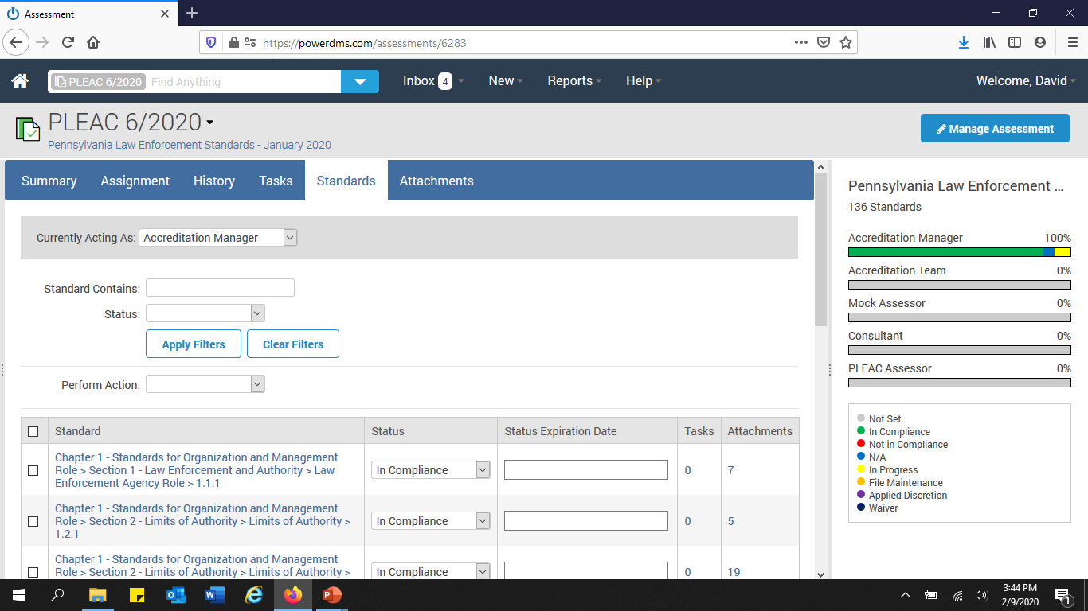

Slide 78
Not applicable (N/A)
Locate the N/A standards for your agency
  Select
    “Perform Action” drop down
    “Set Status”
      N/A
    “Status Expiration”
    “Save Pending Changes”

Slide 79
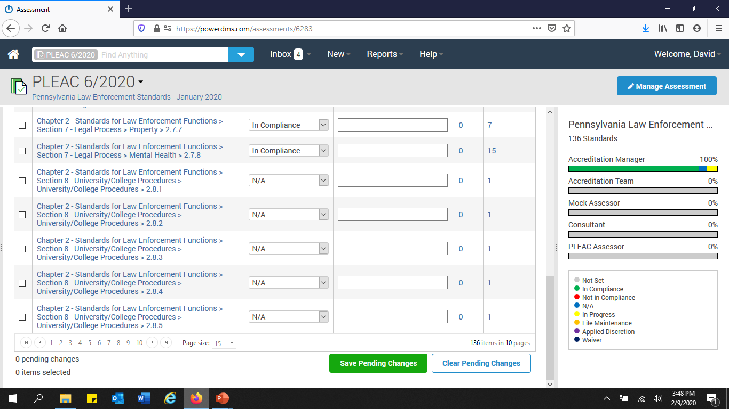

Slide 80

What does an electronic file look like?

Slide 81
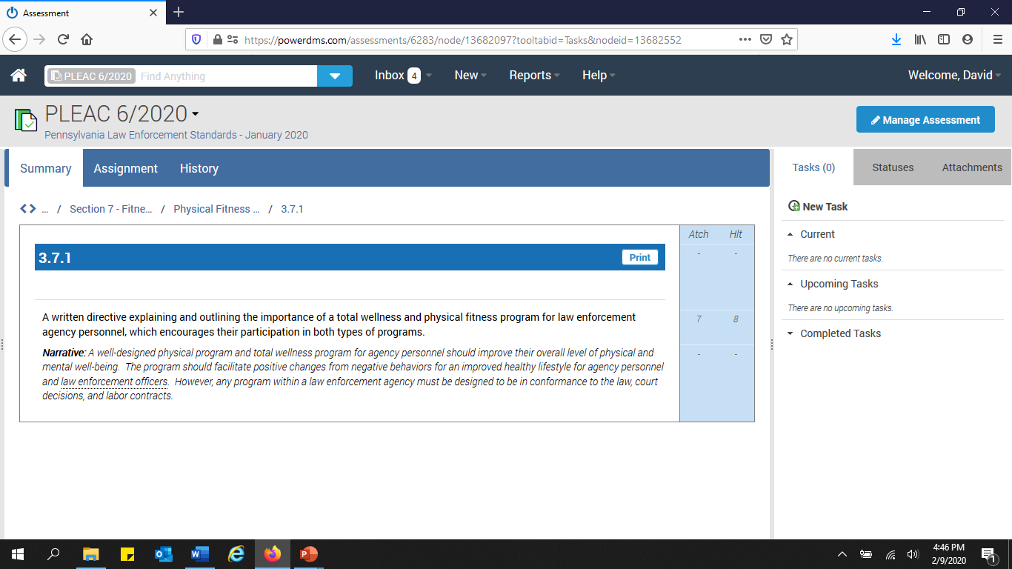

Slide 82
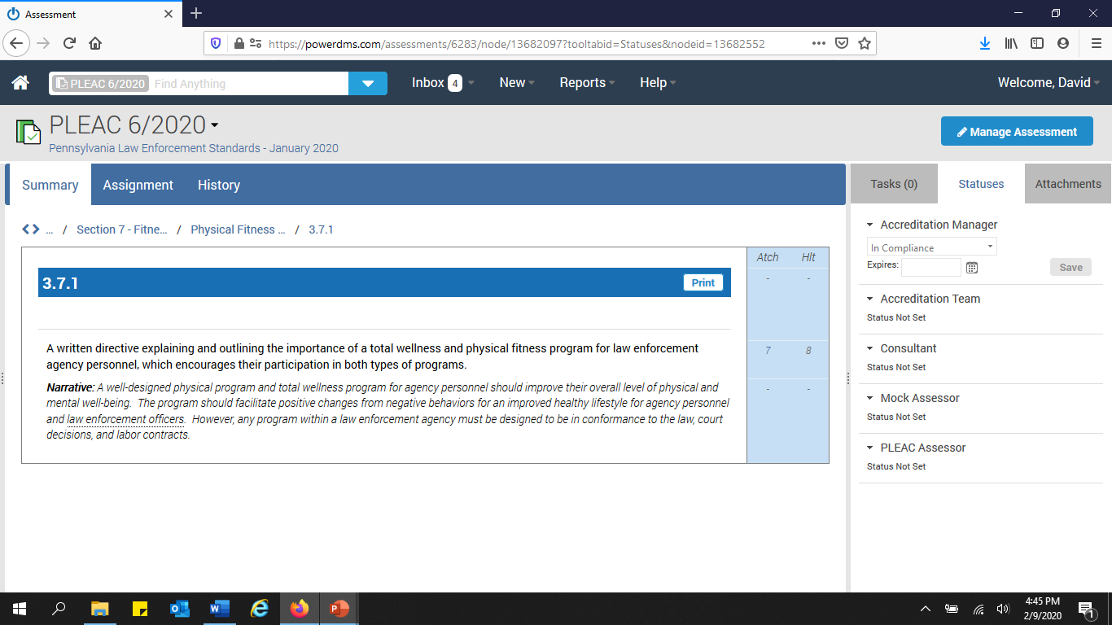

Slide 83
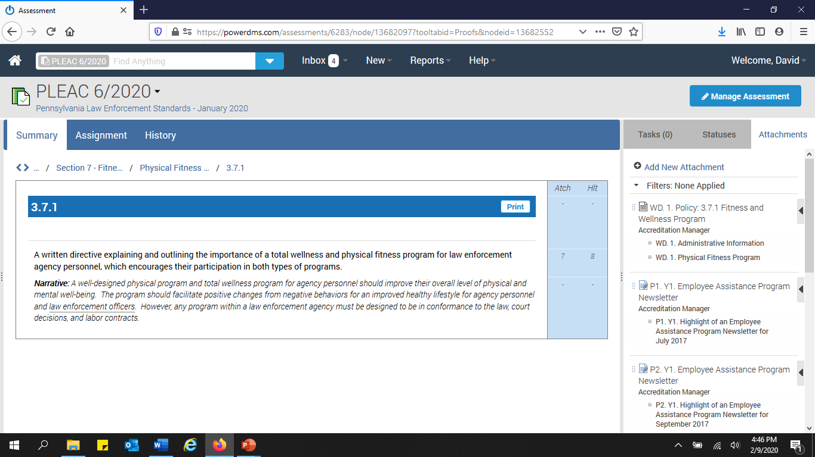

Slide 84
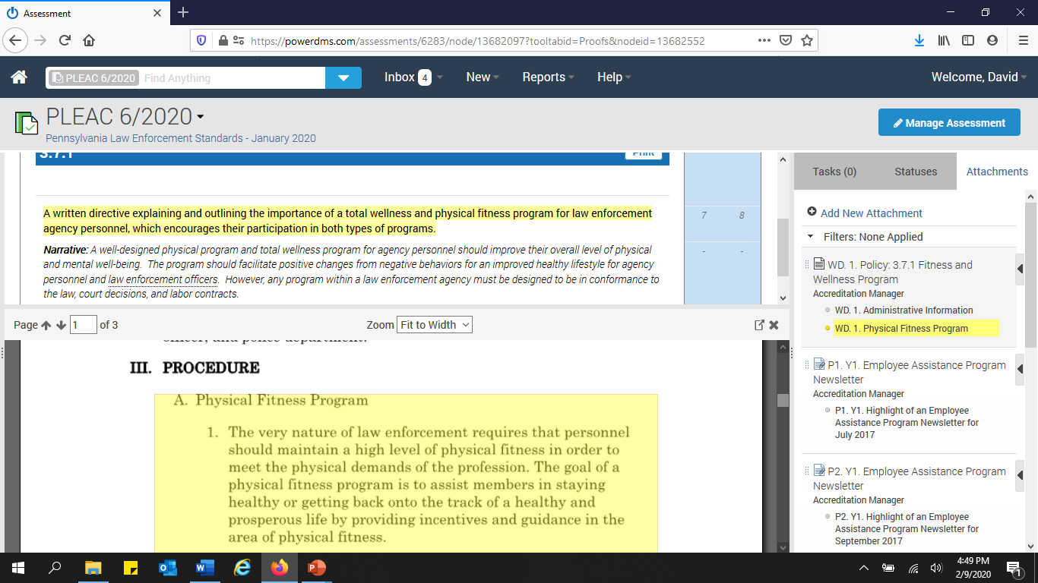

Slide 85
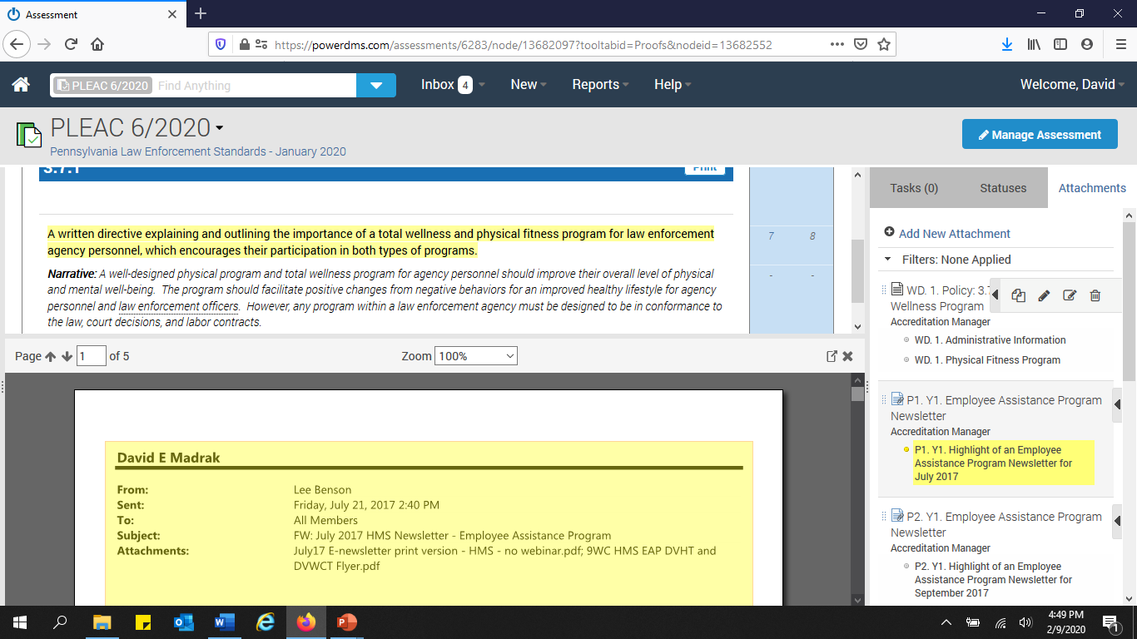

Slide 86


Slide 87

How do I create a file?
Consult the Best Practices in Power DMS document

Slide 88


Slide 89


Slide 90


Slide 91
Best Practices
Task
Status
Attachments
File
Power DMS File
Simple Note
Legend
Labeling
Highlighting
Single line
Continuous
Linking

Slide 92
Best Practices
Single document satisfies multiple bullets
“Map-out” specific bullets within standard
Group highlights by bullet not term of compliance
Simple Notes
No memoranda or signature required

Slide 93
Legend – General
Written Directive
WD
Proof of Compliance
Proof
P
PR
PF
Year
Year
Y
YR
Bulleted Letter
A, B, C, D,, etc. (must always be present for bulleted standard)

Slide 94
Legend – Simple notes
Interview
INT
Memo-to-File
MTF
Not Applicable
N/A
Non-Occurrence
NO
Observation
OBS

Slide 95


Slide 96


Slide 97


Slide 98


Slide 99
Standards
Standard with No Bullets

Slide 100


Slide 101


Slide 102
Standards
Standard with Multiple Bullets

Slide 103


Slide 104


Slide 105


Slide 106


Slide 107

So I have the Best Practices in Power DMS document to help me through this process, but are there other resources available to give me guidance?

Slide 108

Sample Assessment
  Power DMS – Pennsylvania Chiefs of Police Association
    https://powerdms.com/ui/login.aspx?formsauth=true
Power DMS
  Success Community
Accredited agencies
Professional services

Slide 109

SAMPLE Assessment

Slide 110
Sample Assessment
Created by PLEAC
Questions
Recommendations
Purpose
Assist
Accreditation Managers
Assessors
“Living” documents
Continuously updated

Slide 111
Access to the Sample assessment
Contact Andrea Sullivan at the Pennsylvania Chiefs of Police Association
Do NOT have to be a Power DMS subscriber to view
www.powerdms.com
Site Key
PLEAC
Username: Email Address
Password: Pleac2015
Case sensitive password

Slide 112
What does the Sample Assessment typically consist of?
Policies
Proofs of Compliance
Notes
How proofs are to be shown
Address specifc issues

Slide 113


Slide 114


Slide 115


Slide 116


Slide 117


Slide 118


Slide 119

Can I review a previous accreditation assessment?

Slide 120


Slide 121


Slide 122


Slide 123

FYI
Multiple Monitors
PDF – Portable Document Format
  Ability to convert to or scan a document via a computer or printer to PDF
    Adobe
    Nuance

Slide 124

FYI
Media Files
  Video tutorial by Ryan Cywinski, Hanover Township Police Department and Vice President of the Pennsylvania Police Accreditation Coalition
    Located within the PLEAC Sample Assessment and Power DMS Success Community

Slide 125

Mock Accreditation Assessment
Pennsylvania Police Accreditation Coalition

Slide 126
Mock Assessors
Access
  New User
Group
  Mock Assessors
    “Rights”
      Create reports
    Role
      Mock Assessor
        Participate
      Accreditation Manager
        Observe

Slide 127
Mock assessors
Send “login” information to mock assessors
Unless requested, wait for the mock accreditation assessment to be completed before making the suggested changes within the files

Slide 128
The mock assessors are done, what do I do next?
Create a “Report” from the mock accreditation assessment
  Attachments
    Simple Notes
    Mock Assessor
  Filter
  Export
    Excel, PDF, Word

Slide 129


Slide 130
Accreditation Assessment
Create access and group information for the PLEAC assessors just as was done for the mock assessors
“Unlock” key will be assigned by the Pennsylvania Chiefs of Police Association
Reports will be created by the PLEAC assessors
The Accreditation Manager must have the ability to view and make corrections as needed to files

Slide 131

How do I create assessor accounts?

Slide 132


Slide 133


Slide 134


Slide 135


Slide 136


Slide 137
And finally…
Pre-existing Standard Compliance Forms
Do NOT need to be scanned and attached into an accreditation assessment
Accreditation Assessment Closure
Do NOT close until Final Report is received and approved by PLEAC

Slide 138

Points-of-Contact
  Richard Hammon
    rhammon@pachiefs.org
  Andrea Sullivan
    asullivan@pachiefs.org
  717-236-1059
  www.pachiefs.org

Slide 139

Questions

